Slide 1
Reviewing Ellucian Advise Alerts
on your
BSU Advisees

Slide 2
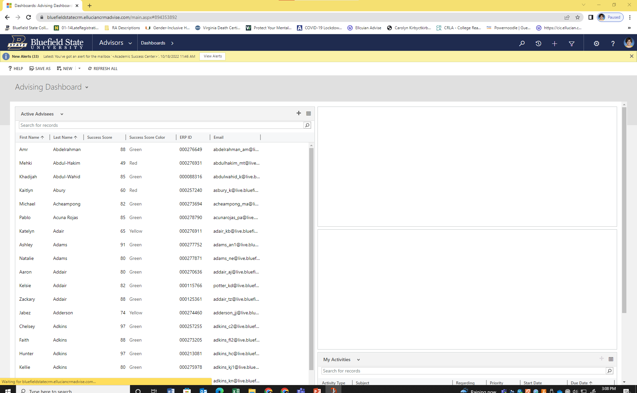
Click Here

Slide 3
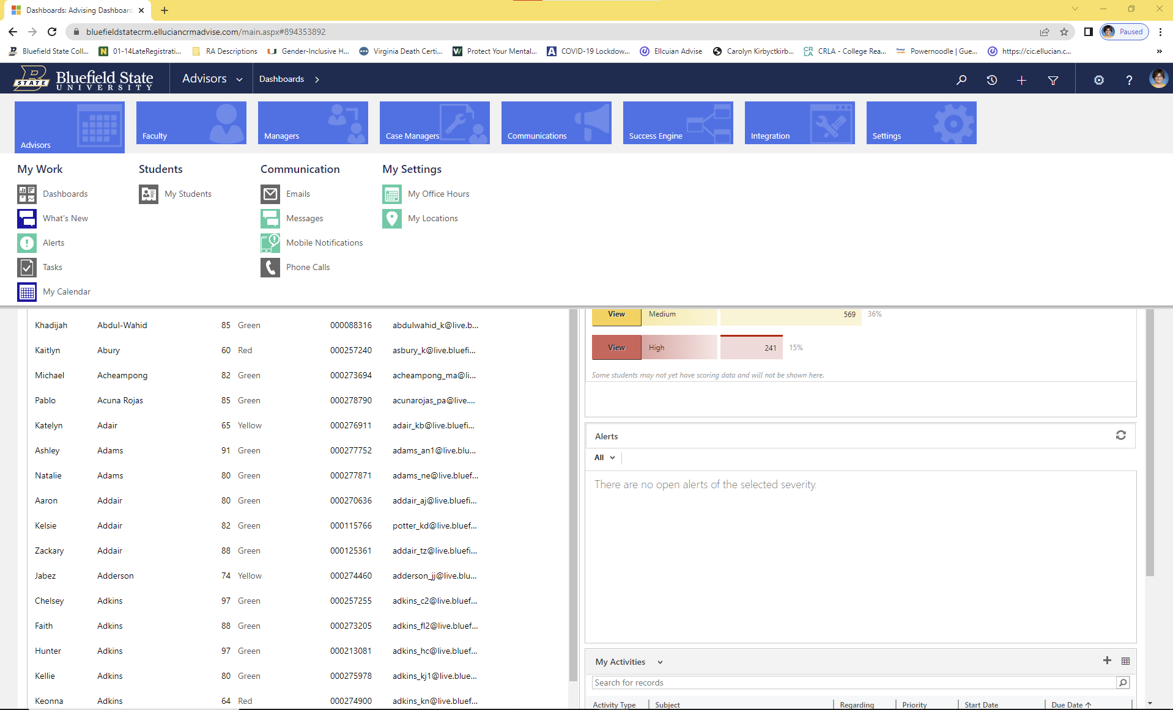
Click “Alerts”

Slide 4
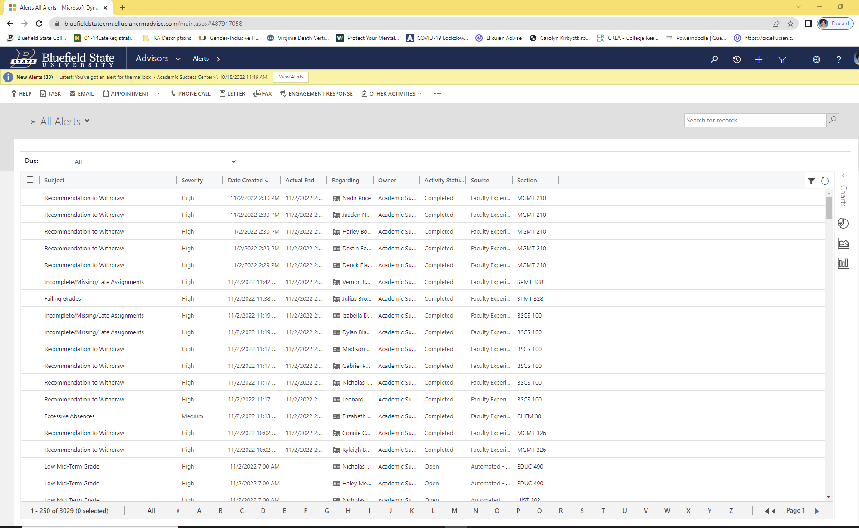
Click IT!

Slide 5
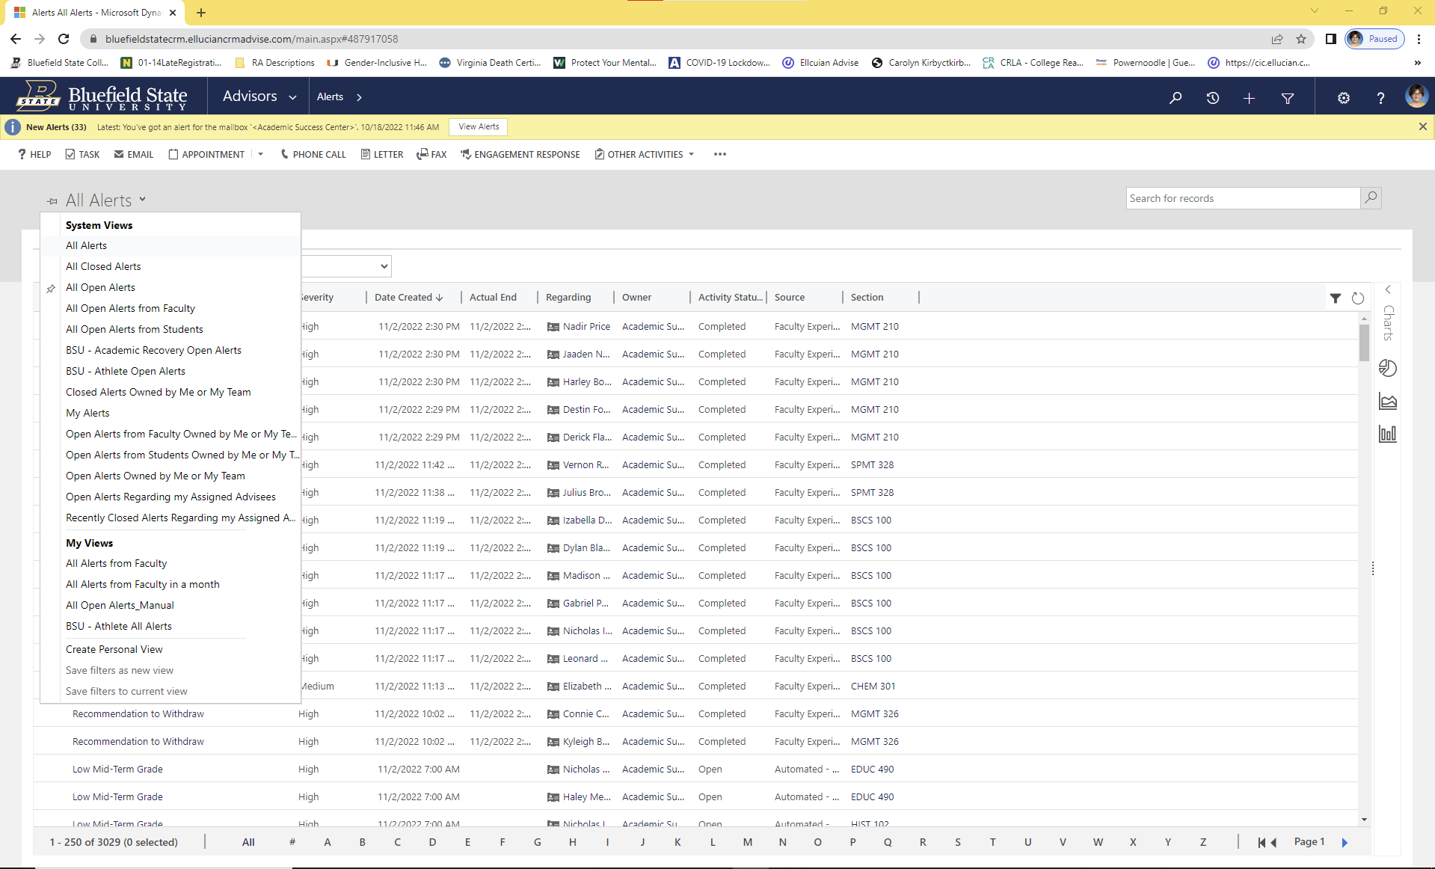
Choose this and pin it

Slide 6
This shows recently closed alerts in the last two weeks

Slide 7
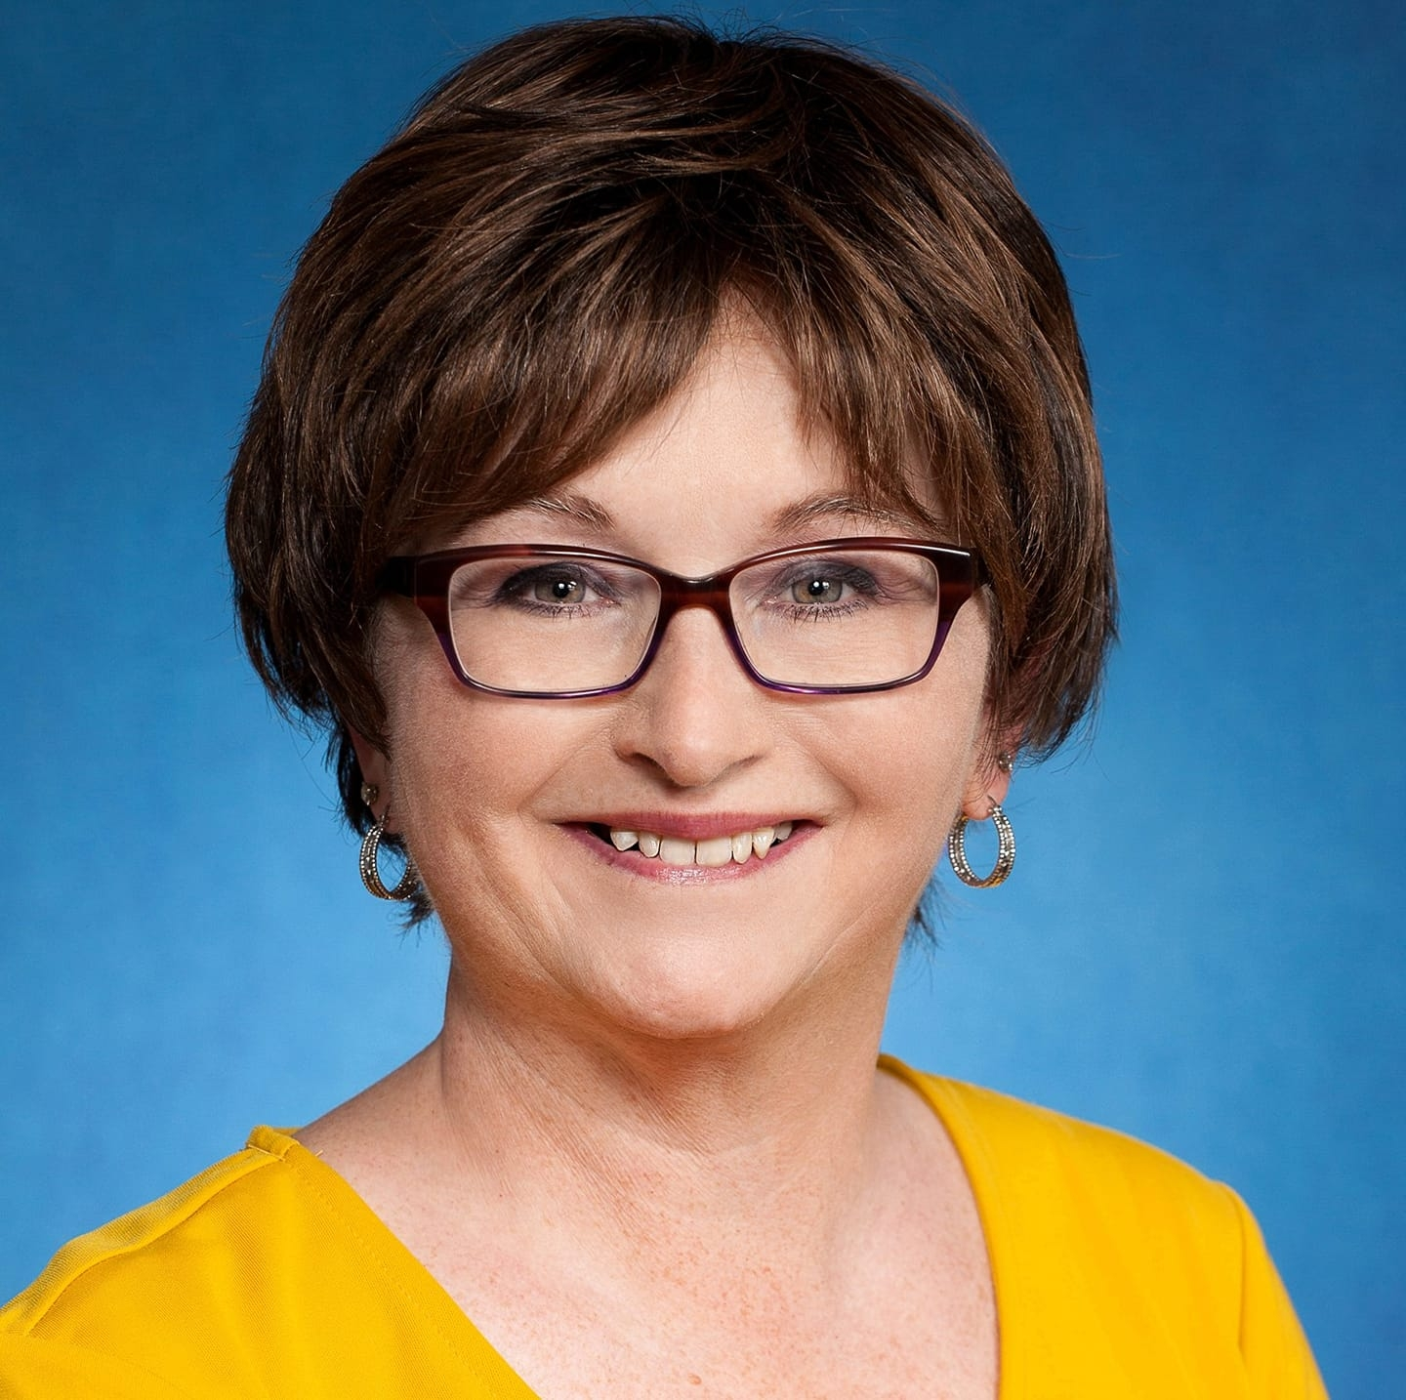
I’ll be glad to help!
Please call me and I’ll come by your office!
Carolyn Kirby
X4098

