Slide 1
Finding Money for College
FAFSA Basics
Tammy Martin
Financial Aid Manager
November 2021

Slide 2
Who can get federal student aid?
U.S. citizen/national or eligible non-citizen
High school diploma or equivalent
Eligible degree/certificate program in college/career school
Student has valid Social Security number
Satisfactory academic progress in college/career school
Who is eligible for financial aid?
Information about eligibility
Notes:
**This is not a comprehensive list of eligibility criteria for federal student aid. For complete details, counselors may wish to visit ifap.ed.gov and go to the Student Eligibility chapter of the Federal Student Aid Handbook. (Students should visit StudentAid.gov/eligibility.)**
Basic eligibility criteria for federal student aid:
Demonstrate financial need (for most programs)
US citizen/national or eligible citizen such as a permanent resident (there are additional categories of eligible noncitizen; refer to Federal Student Aid Handbook for details)
High school diploma or the recognized equivalent (GED certificate, state certificate such as HiSET or California High School Exit Exam, or completion of at least a two-year program toward a bachelor’s degree, or the student must have academically excelled in high school); or homeschooler who has completed his/her home-school education as recognized by the state government; or enrolling in an eligible career pathway program and meeting one of the “ability-to-benefit” alternatives described at StudentAid.gov/eligibility/basic-criteria
Student enrolled as a regular student in a degree or certificate program that is eligible to be paid for by federal student aid funds; student also must be attending a college or career school that participates in the federal student aid programs
SSN: the exception here is students from the Republic of the Marshall Islands, the Federated States of Micronesia, or the Republic of Palau
Males (any person assigned the sex of male at birth) must register for Selective Service within 30 days of their 18th birthday (within 30 days before or 30 days after, for a total window of 60 days).
If you are working with a male student who did not meet the 60-day timeframe, direct him to register immediately at www.sss.gov. Late registrations are accepted until the age of 26.
If you are working with a male student aged 26 or older who did not register, you should direct him to the financial aid office at the college he plans to attend. Before he can receive federal student aid, he will have to prove that he did not “knowingly and willfully” fail to register. The financial aid administrator will tell him what documentation he needs in order to do so.
In broad terms, a student making satisfactory academic progress (SAP) is moving toward receiving his or her degree or certificate at a pace that is acceptable to his or her school. Each school sets its own SAP policy.

Slide 3
How do I apply for aid?
Start Here:
Federal Student Aid- Studentaid.gov
State Financial Aid -collegeforwv.com
BSC Institutional Aid-bluefieldstate.edu/form/contact-financial-aid#no-back
Notes:
Re the FAFSA form, stress that it is a free application. If a student finds him or herself at a website that asks for payment, the student is not at the official U.S. Department of Education FAFSA site. There is no fee to file the FAFSA form.
[Note to counselor: If you are working with students who don’t have access to the internet and therefore need to fill out the FAFSA form on paper, you can download a PDF at fafsa.gov (click on “FAFSA Filing Options”) and print as many copies as you need. Alternatively, a student may call 1-800-4-FED-AID (1-800-433-3243) to request a print-out of the FAFSA PDF.]
If there are specific state, school, or scholarship programs that most or all of your students apply for, you might insert their URLs here, or state where to get applications.

Slide 4
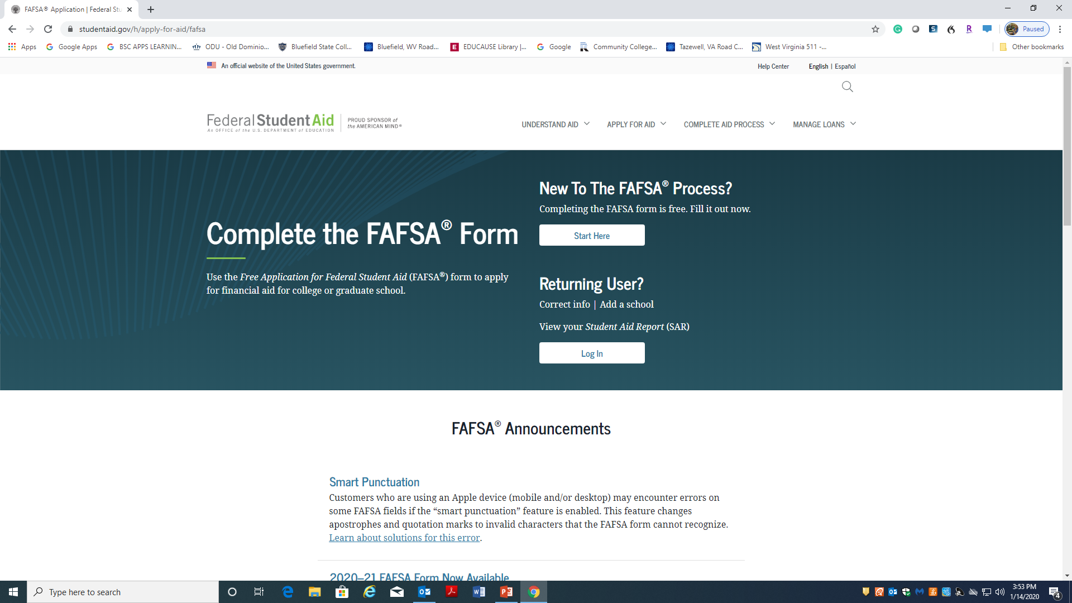
Apply for FAFSA
Login to the Internet, go to Google Chrome, type in
FAFSA
Click on FAFSA
Application
Complete each
Section -

Slide 5
How do I apply for federal student aid?
Create a username and password called the FSA ID.
Learn about the FSA ID and how to create one.
You and your parent must each create your own FSA ID; you can’t share one.
If you provide an email address when creating your FSA ID, it must be a unique email address just for you (can’t provide same email address for more than one person’s FSA ID).
Don’t tell anyone your FSA ID!
Use computers in the BSC William B. Robertson Library
to complete your FAFSA.
Please keep a note of your FSA ID, password, safe key, email, and phone number
in a safe place.
Notes:
Students and parents can create FSA IDs at any time. The student does not have to be ready to fill out a FAFSA form.
One benefit of creating an FSA ID is that you will be able to use it to sign the FAFSA form electronically, thus speeding up the process greatly.
Important to note here that student and parent need separate FSA IDs – one each. [Only one parent needs an FSA ID, even if both parents’ info will be provided on the FAFSA form.]
(To find out whether a parent’s information will be needed on the FAFSA form, a student can visit StudentAid.gov/dependency.)
It’s strongly encouraged that you provide an email address and mobile phone number when you create your FSA ID; this will help if you forget your username or password and need to reset it. It’s important to understand that your email address and phone number can be used for only one FSA ID. So for instance, if a parent and child share an email address, they’ll need to create a second one so that they’ll each have a unique email address to use when creating an FSA ID.
An FSA ID is a signature as well as providing access to private information. To protect themselves from identity theft and other types of fraud, students and parents should not tell anyone their FSA IDs.

Slide 6
How do I apply for federal student aid?
2. Gather the documents you need to apply.
Find checklist of what’s needed on the FAFSA Process
Optional: Preview some of the FAFSA questions on the FAFSA on the Web Worksheet—2022-2023
Notes:
The FAFSA Process infographic provides a visual overview of the process of filling out and submitting a FAFSA form, and what happens afterwards.
The FAFSA on the Web Worksheet provides an idea of the types of FAFSA questions. However, not every question on fafsa.gov appears on the worksheet.

Slide 7
How do I apply for federal student aid?
3. Watch for response by email or regular mail, confirming your FAFSA was processed.
Double-check that your info is correct by logging on at the FAFSA site and reviewing your data.
Correct any mistakes and submit the corrected info.
For example: incorrect income, incorrect number in family.
Don’t update info that was correct on the day you signed your FAFSA.
4. Watch for emails or letters from Bluefield State College.
Provide BSC with any additional paperwork requested.
Meet all deadlines, or you could miss out on aid!
Notes:
The online or paper Student Aid Report (SAR) will list the student’s EFC and will show the information the student reported on the FAFSA form (except for tax info imported via the IRS DRT). The student can review the FAFSA information online by logging in at fafsa.gov.
Corrections can be made online at fafsa.gov or on the paper SAR. Online corrections can be processed immediately in some cases. The student will then receive a new SAR, and the school will receive updated information.

Slide 8
What happens next? Where can I get more info?
Review and understand BSC’s aid offer.
Keep in touch with the financial aid office to find out when and how you will get your aid.
StudentAid.gov
Info about aid programs
Links to free scholarship and college searches
Contact information for Federal Student Aid
1-800-4-FED-AID or studentaid@ed.gov

Slide 9
BSC Financial Aid Contact Information
Mrs. Tammy Martin – Financial Aid Manager
(304) 327-4426
tmartin@bluefieldstate.edu
Ms. Emily Mann - Loan Officer
(304) 327-4021
emann@bluefieldstate.edu
Ms. Robin Shanklin - Pell Officer
(304) 327-4023
rshanklin@bluefieldstate.edu
Mrs. Donna Catron - Financial Aid Counselor
(304) 327-4020
dcatron@bluefieldstate.edu
Notes:
[Note to counselors: You may wish to hand out the one-page fact sheet titled “Federal Student Aid: Find the Information You Need.” The fact sheet lists frequently-asked-about federal student aid topics and easy URLs to find the answers. If you want to have students download the fact sheet themselves, give them this URL: StudentAid.gov/resources#find-aid-info.]
[Note to counselors: Remember to check out FinancialAidToolkit.ed.gov/resources to browse and download documents, videos, sample tweets, infographics, and more that you can use to raise students’ awareness and understanding of federal student aid. Please remember that the Financial Aid Toolkit is for you, the counselor; send your students to StudentAid.gov for information relevant to them, and to StudentAid.gov/resources to browse the handouts, videos, etc.]

