Slide 1
IMPROVING CHILDREN’S MATH PERFORMANCE THROUGH EVIDENCE BASED TRAINING
Dr. Saeeda Khanum
Fulbright Postdoctoral fellow at LDS, Harvard Psychology Department
03.11.2020

Slide 2
Improving Children’s Math Performance through Evidence Based Training
Why Mathematics is so Important?
Why is it easy for some and harder for other to learn math
What are the key factors early in learning of mathematics
Systems of core knowledge
How we learn math?
Experimental evidence for enahncing math learning
Future directions
Q & A

Slide 3
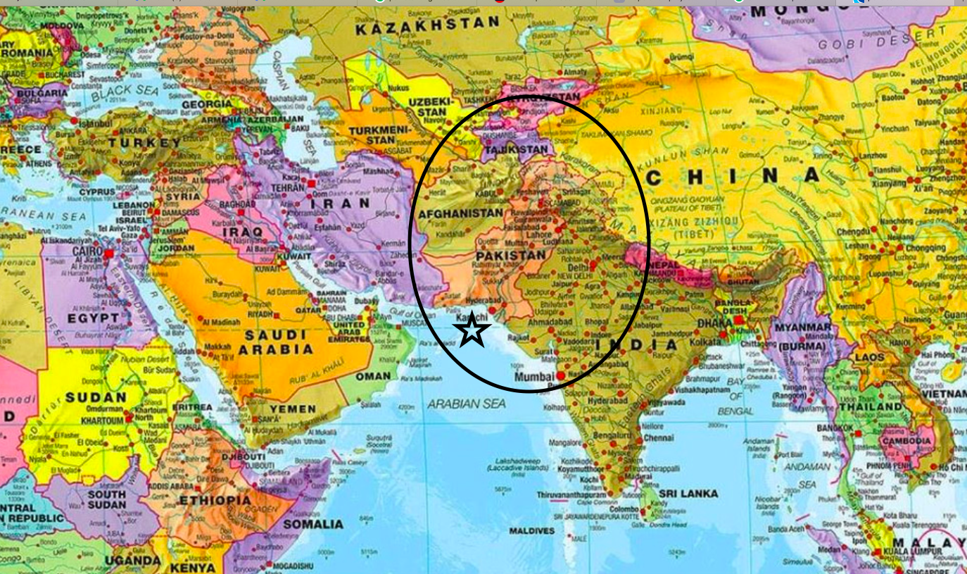

Slide 4
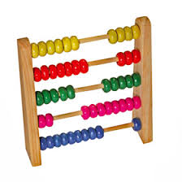
Why it is important to study numbers
?
Notes:
Numbers in day to day life: playing games, todays temperature, time, combination of your locker, money you carry, number of , chairs why all these matters? Numbers simplify our world,”, "We want to believe that there's a way to be faster, better or smarter-and numbers seem to be able to help us do that."

Slide 5
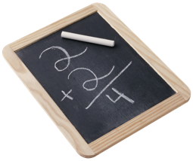
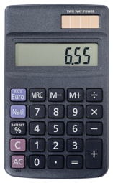
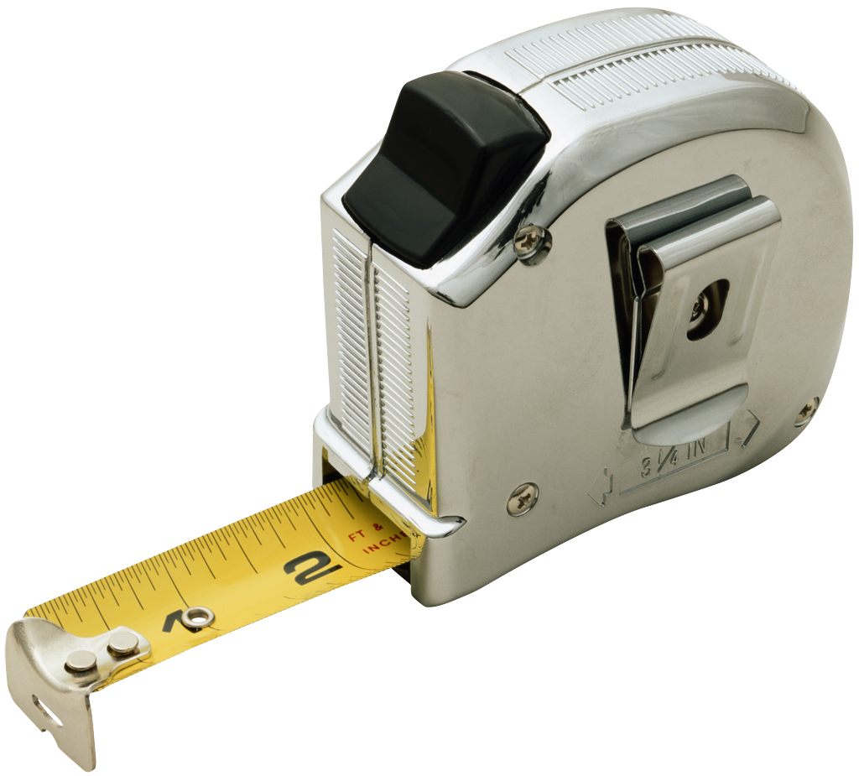
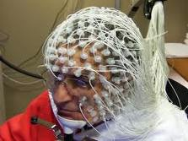
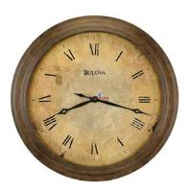
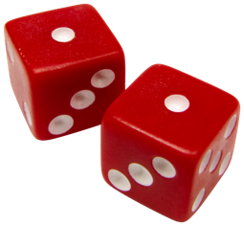
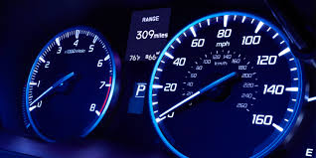

Slide 6
LearnOBots
Innovations
Current era
Any field

Slide 7
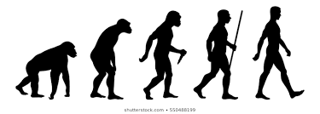
Core knowledge
Uniquely human capacities? Productive human capacities we have?
What leads humans to develop new systems of knowledge? Humans have similar perceptual, action, systems as animals?
How do we learn new concepts? Different ways of organizing things..e.g. green apple vs. red apple
Does human cognition have constant universal properties/systems?
Origin and development of knowledge? How can we answer?

Slide 9
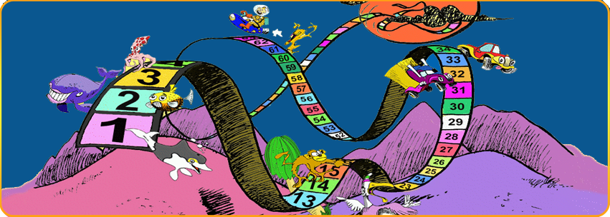
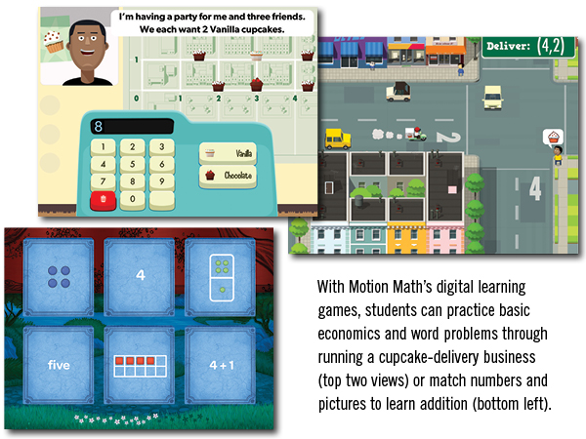
Strengthen the brain mechanisms of number processing
Establish the mental number line
Teach and practice counting
Teach and practice early addition and subtraction
Encourage Fluency (Automatic Processing)
Helping children with dyscalculia
The Number Race has been scientifically tested

Slide 10
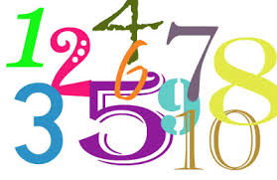
Main Variables
Non-symbolic numbers (arrays of dots, sequence of sounds/tones)
Children, adults can add, subtract, compare pair of dot arrays when approximate accuracy is required (McCrink & Wynn,2004, Barth et al, 2005,2006).
Symbolic numbers
Symbolic numbers can be presented as number symbols e.g., Arabic numbers, like 1, 2 3 or number words like one, two, three, etc.
One, two, three…..

Slide 11
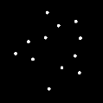
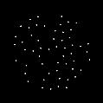
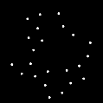
Operational Definitions
Non-symbolic numbers (approximate)
(addition / comparison of arrays of dots)
Symbolic number (Exact)
Addition problems (like kids do in the classroom)
12 + 7
+
More
Less
Notes:
We used an experimental procedure to test the extent to which engaging the ANS causally enhances subsequent symbolic arithmetic. By systematically manipulating the content of exp. tasks and analyzing the resulting effects, we also begin to clarify the specificity of the relationship between the ANS and symbolic mathematics.

Slide 12
Infants are sensitive to number
Numerical change detection. Brannon - preferential looking time?

Slide 13
Two core systems of number representation (innate systems with mathematical content )
Approximate number system
Object tracking system
Two system view of numerical cognition (Feigenson et al,2004; Ansari, Lyons, Van Eimeren, & Xu,2007; Feigenson, et al,2002; Lipton & Spelke, 2004; Van Herwegen, Ansari, Xu & Karmiloff-smith,2008; Simon, Hespos & Rochat, Uller, Carey, Huntley-Fenner & Klatt,1999; Xu,2003; Hyde & Spelke, 2011).
Humans build systems of abstract number by productively combining the outputs of these systems, and this process depends, in part, on the acquisition and use of natural language.
Notes:
A wealth of research provides evidence

Slide 14
Approximate approximate number system
encodes the approximate numerical magnitude, or numerosity, of a set
It produces an intuitive “ Number sense ” -our ability to quickly understand, approximate, and manipulate numerical quantities (Dehaene, 2001).
A key psychophysical signature of the ANS is that it obeys Weber’s law: Observers’ ability t discriminate two approximate number representations does not depend on the total number of items or the absolute difference between them, but instead on the ratio between the two quantities (Dehaene, 1992; Feigenson, Dehaene, & Spelke, 2004).

Slide 15
Approximate rep. of numerical magnitude CONTD…..
Newborn can discriminate between numbers differed by ratio of 1:3 (12 vs. 4, 18 vs. 6) but fail to discriminate the numbers differed by ratio 1:2 (8 vs. 4). (Izarad, sann, Spelke, & Steri , 2009)
6 months old can discriminate numbers differed by ratio 1:2 but not 2:3 ( Xu & Spelke, 2000, Lipton & Spelke 2003, Xu, Spelke & Goddard 2005)
9-10 months of age ratio drops to 2:3 (Lipton & Spelke, 2003, Xu, Arriaga 2007)
3 years old can discriminate by ratio of 3:4, 6 years old can discriminate by ratio 5:6, adults by 10:11 (Halberda & Feigenson (2008).
Importantly, at any given age, infants show the same ratio limit for different types of arrays: an infant who can just discriminate arrays of 8 vs. 16 dots also will just discriminate sequences of 8 vs. 16 sounds or actions (Lipton & Spelke, 2003; Wood & Spelke, 2005).
Notes:
Precision of numerical quantities keeps more sophisticated over the development

Slide 16
Approximate rep. of numerical magnitude CONTD…..
Imprecise, quick with larger numerosities,
discrimination of two quantities is proportional to their ratio (Weber Law), robust across modalities (Dehaene, 1999; Lipton & Spelke 2003, Wood & Spelke 2005, Feignson, Dahaene, Spelke 2004).
Unlike the numerical system-the ability is non-symbolic- It operates over items rather than Arabic digits,like over smaller quantities (1-3,4)
It is non-verbal- It is seen in animals without language (Fish, rats, chickens, monkeys, Agrillo, et al,,2008, Brannon & Terrace,2000; Cantlon & Brannon, 2006; Meck & Church,1983; Vallortigara, et al,2010) and in infants-language has not yet developed (Brannon & Terrace, 1998; Izard, et al,2009; Xu & Spelke, 2000;Libertus & Brannon, 2010; Wynn, 1998), Munduruku (Pica et al,2004; Deheane, et al, 2008)
Despite these limitations
It is powerful and evolutionarily pervasive

Slide 17
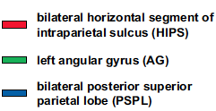
Approximate rep. of numerical magnitude CONTD…..
Specific brain basis-In human infants, human adults, and primates a portion of parietal lobe, IPS respond to number (Ansari, Dhital & Soon, 2006; Hyde Boas, Blair, & Carey,2010; Nieder & Miller, 2004; Piazza, et al,2004).
HIPS (activated whenever number are manipulated independent of notation)
Comparison of numbers, Subtraction, Approximation, Estimation
Non-symbolic tasks
AG (manipulation of numbers in verbal form)
BPSL (support attentional orientation on
the mental number line), (Deheane,et.al, 2003)
Still accessed in skilled adults
Used for representations and operations

Slide 18
Object tracking system
encodes the numerical identity of individual items precisely
Jevons (1871) showed that humans perceive the number of 1-3 items, yet ability to enumerate more than 3 items becomes increasingly inaccurate, slower, and more effortful as number increases.
It serves to represent sets of up to 3 (children) 4 (adults) numerically distinct items (Feigenson & Carey, 2003, 2005, Mandler & Shebo,1982, Trick & Pylyshyn,1994).
Notes:
the first core system captures cardinal information, but only does so imprecisely, whereas the second system captures the exact number of individuals in an array, but only when those numbers are small.

Slide 19
Symbolic number system?
Symbolic number system
Children learn language and other symbol systems, they begin to combine their core numerical representations productively, in uniquely human ways. These combinations may give rise to the first truly abstract concepts at the foundations of mathematics
Symbolic language-uniquely human Capacity
For most children, language provides the critical system of symbols for combining the two core systems, and some evidence suggests that it may be necessary for this construction.

Slide 20
Mapping of non-symbolic numbers system on symbolic number system
Pre-school Children recruit/map onto non-symbolic system when confront symbolic approximate problems with limits that reveal three signatures of the non-symbolic arithmetic system:
a ratio effect on accuracy,
addition performance that is as accurate as direct comparison,
subtraction performance that is less accurate than comparison.
(Gilmore, McCarthy, Spelke 2007, Barth et al, 2005, Mundy & Gilmore, 2009)

Slide 21
ANS AND SYMBOLIC MATH
ANS is a cognitive foundation for higher-level symbolic math
(Dehaene, 1992; Feigenson et al., 2004; Gallistel & Gelman, 1992; Piazza, 2010).
Tasks involving purely symbolic numbers and exact arithmetic reveal signatures of non-symbolic, approximate number representations (see Piazza, 2010 for a review). For example, when adults or older children are asked to determine which of two symbolic numbers is larger, their performance depends on the numerical distance between the numbers to be compared (e.g. Deheane & Akhavein, 1995; Dehaene, Deheane-Lambertz & Cohen, 1998; Moyer & Landauer, 1967; Temple & Posner, 1998).

Slide 22
Neuropsychological and transcranial magnetic stimulation research shows that damage or impairment of parietal brain regions thought to underlie the ANS alters the ability to performance symbolic numerical computations (e.g. Cappelletti, Barth, Fregni, Spelke, & Pascual-Leone, 2007; Dehaene, Piazza, Pinel, & Cohen, 2003). overlapping parietal brain regions are activated during processing of number in both symbolic and non-symbolic number formats (Piazza et al., 2007; Piazza, 2010 or Dehaene et al., 2003).
Individual differences in ANS acuity correlate with mathematics achievement scores (e.g. Bugden & Ansari, 2011; DeWind & Brannon, 2012; Halberda, Mazzocco, & Feigenson, 2008; Libertus, Feigenson, & Halberda, 2011; Libertus, Odic, & Halberda, in press; Halberda, Ly, Wilmer, Naiman, & Germine, 2012; Budgen & Ansari, 2011; Lourenco, Bonny, Fernandez, & Rao, 2012; Gilmore, McCarthy, & Spelke, 2010; but see Lyons & Beilock, 2011).
Practice with or training of the ANS, either alone or with training of symbolic numbers, leads to gains in symbolic mathematics performance (Park & Brannon, 2013; Räsänen, Salminen, Wilson, Aunio, & Dehaene, 2009; Wilson, Dehaene, Dubois, & Fayol, 2009; Wilson, Dehaene, Pinel, Revkin, Cohen, & Cohen, 2006; Wilson, Revkin, Cohen, Cohen, & Dehaene, 2006).

Slide 23
Gap in literature
Indirect or correlational evidence links primitive numerical intuitions with symbolic math development.
Question
Whether experiences operating on approximate number representations enhance exact symbolic number performance or not?
How
Causal effect of non-symbolic on symbolic number processing through training paradigm

Slide 24
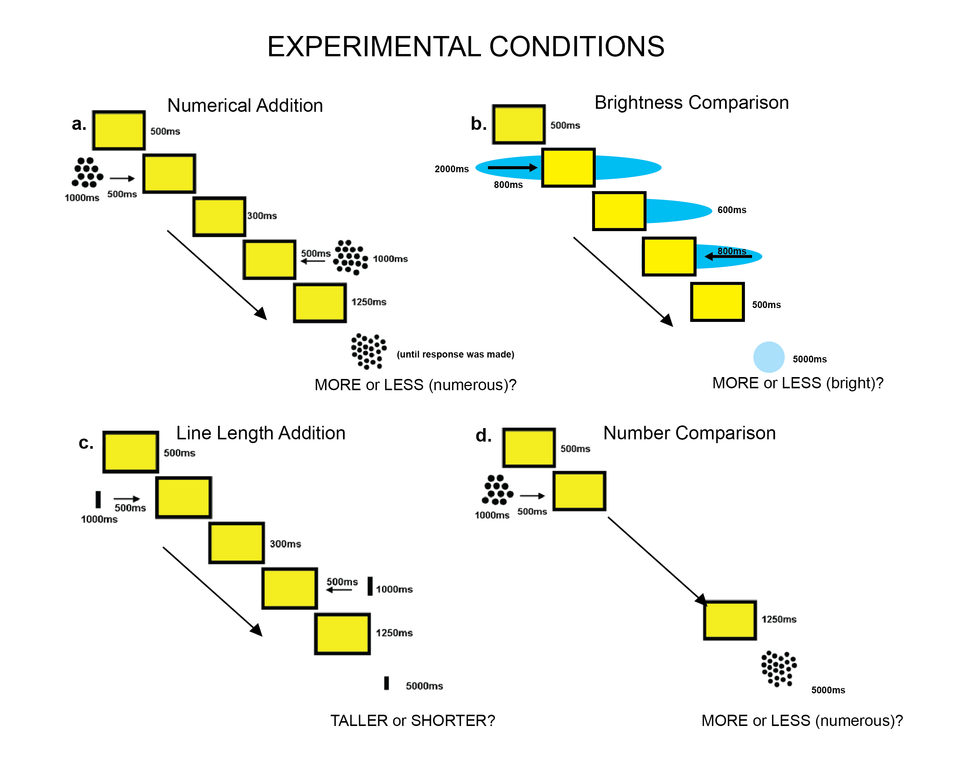
Notes:
same magnitudes of difficulty (7:4 ratio comparisons and 7:5 ratio comparisons), timing, and total number of practice and real trials in all tasks

Slide 25
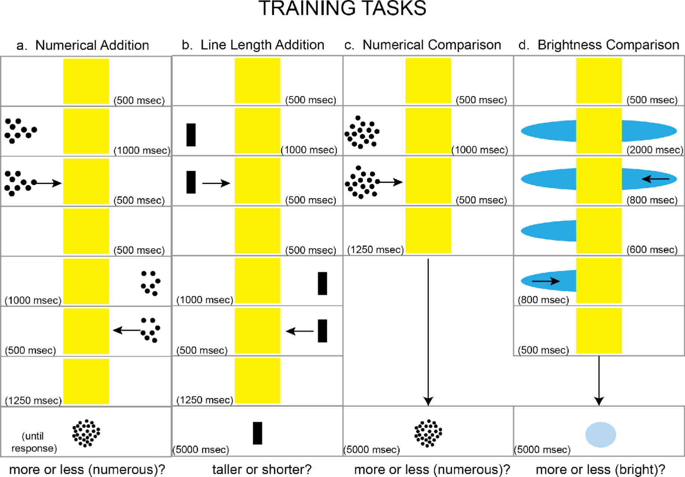

Slide 26
Training conditions
1. Non-symbolic approximate addition
Numerical addition of non-symbolic dot arrays (see Barth et al., 2005; 2006; Gilmore et al.2010) (Park & Brannon, 2013). In addition to requiring the engagement of the ANS, task may require transformational operations at the core of symbolic arithmetic concepts, making it an ideal task to engage cognitive mechanisms in common with those used for symbolic mathematics (Barth et al., 2005; Gilmore et al., 2010).

Slide 27
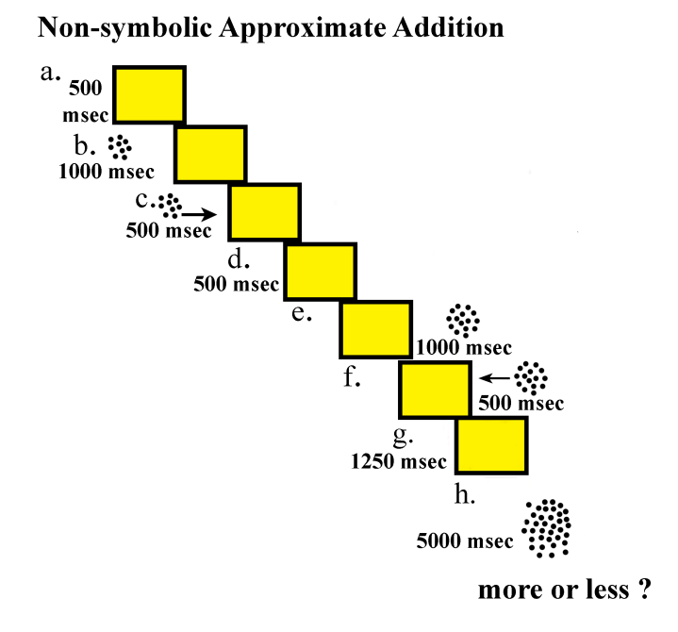

Slide 28
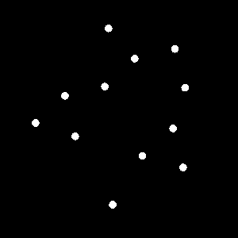
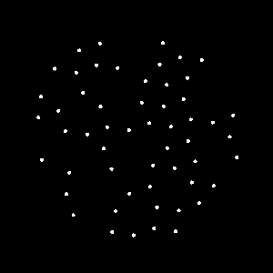
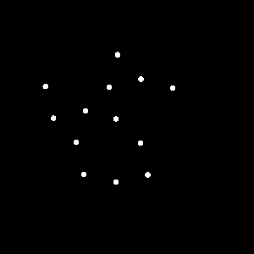
More or Less

Slide 29
Non-numerical stimulus controls
Two sets of numerical stimuli were created for each numerical value used in the non-symbolic training problems.
One set of numerical arrays was equated on intensive parameters (individual item size and average inter-item spacing) across all numbers used and varied on the extensive parameters (total occupied area and total luminance).
Second set was equated, on average, by number in the extensive parameters, but varied in the intensive parameters by number. For each numerical value in each set, 5 different numerical arrays were produced that varied in position and spacing of individual dots on the screen.
Such controls have been employed in other studies of numerical cognition (Hyde & Spelke, 2009, 2011; Hyde & Wood, 2011; Izard et al., 2008; Piazza et al., 2004, 2007).
Hyde, D.C. & Spelke, E.S. (2009). All numbers are not equal: An electrophysiological investigation of small and large number representations. Journal of Cognitive Neuroscience, 21(6), 1039-1053.
Hyde, D.C. & Spelke, E.S. (2011). Neural signatures of number processing in human infants: Evidence for two core systems underlying non-verbal numerical cognition. Developmental Science, 14(2), 360-371.
Hyde, D.C. & Wood, J.N. (2011). Spatial attention determines the nature of non-verbal numerical cognition. Journal of Cognitive Neuroscience, 23(9), 2336-2351.
Izard, V., Dehaene-Lambertz, G., & Dehaene, S. (2008). Distinct cerebral pathways for object identity and number in 3-month-old infants. PLOS Biology, 6(2), 275-285.
Piazza, M., Izard, V., Pinel, P., Le Bihan, D., & Dehaene, S. (2004). Tuning curves for approximate numerosity in the human intraparietal sulcus. Neuron, 44(3), 547-555.
Piazza, M., Pinel, P., Le Bihan, D., & Dehaene, S. (2007). A magnitude code common to numerosities and number symbols in human intraparietal cortex. Neuron, 53(2), 293-305.

Slide 30
2. Brightness comparison
Comparing the brightness magnitude of two objects. Cognitive and neural overlap between representations of numerical magnitudes and brightness magnitudes has been highly debated (see Walsh, 2003; Lourenco & Longo, 2011).
Some evidence suggests brightness to be included with space and number in the generalized magnitude system (e.g. Cohen Kadosh & Henik, 2006), whereas other evidence suggests it may be distinct (e.g. Pinel, Piazza, Le Bihan, & Dehaene, 2004).

Slide 31
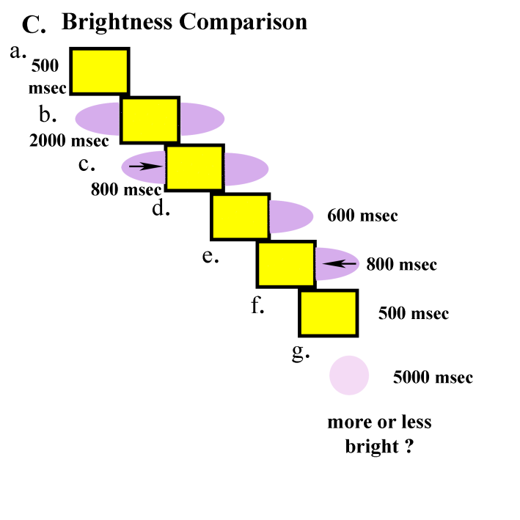

Slide 32
30
40
Difficult
50
60
70
80
Easy
90
100

Slide 33
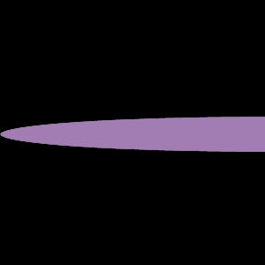
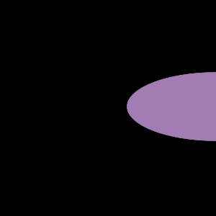
More or Less = lighter or darker

Slide 34
More or Less = lighter or darker

Slide 35
2. Line length addition
Addition of line lengths (i.e. spatial extent). This condition was motivated by the generalized magnitude system hypothesis (Lourenco & Longo, 2001; Walsh, 2003), as well as by recent findings of a relationship between spatial magnitude representation and achievement in mathematics (Lourenco et al., 2012).

Slide 36
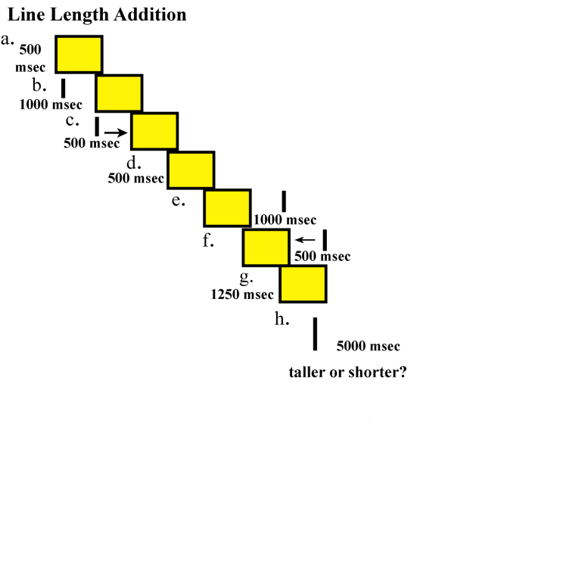

Slide 37
4. Non symbolic approximate comparison
Approximate, non-symbolic numerical comparison emerging work suggests that the ability to compare arrays of objects on the basis of number correlates with mathematics achievement scores in a variety of contexts (e.g. Budgen & Ansari, 2011; Halberda et al., 2008; Lourenco et al., 2012).

Slide 38
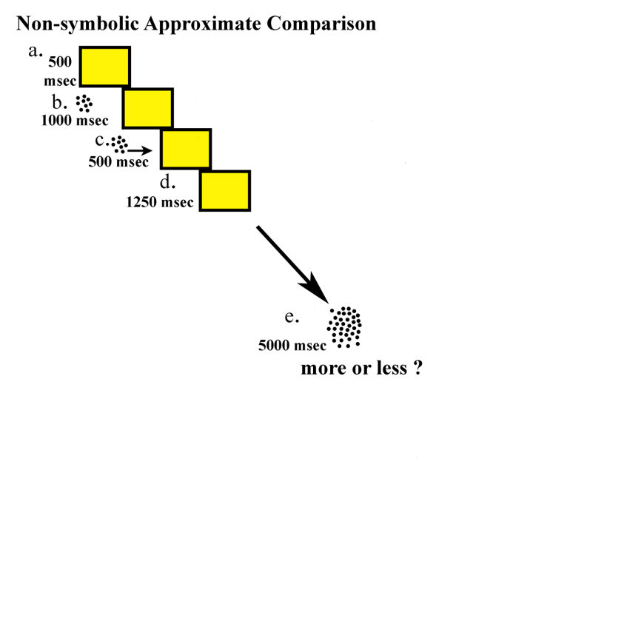

Slide 39
Tasks (Measures) used
Symbolic addition problems

Slide 40
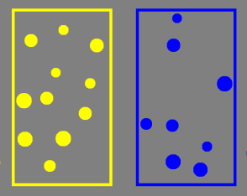
Panamath task–ANS Acuity (Halberda, Mazzocco, & Feigenson, 2008).
computer screen for 2 seconds.
Arrays ranged from 4-15 dots
included numerical comparisons at 6:5, 4:3, 3:2, and 2:1 ratios
On accuracy at each ratio, the Panamath software generated a psychophysical model of performance and an estimate of numerical acuity (a Weber fraction). www.panamath.org.
Notes:
children saw a collection of yellow dots,associated with a yellow cartoon character, and a collection of blue dots, associated with a blue cartoon character, simultaneously presented on a

Slide 41
Objective (Experiment.1)
To test for effects of ANS priming on exact, symbolic arithmetic performance of 7- to 8-year-old children.
Hypothesis
If children draw on ANS representations when they perform symbolic arithmetic, then they may show enhanced performance of symbolic arithmetic if they first are presented with problems requiring non-symbolic approximate number representations,
relative to children who receive the same symbolic arithmetic problems after presentation of otherwise similar, non-numerical control tasks.

Slide 42
Experiment.1
Tasks and measures
Training tasks: 60 trails (RT & Accuracy)
Non-symbolic addition training task
Brightness comparison training task
Symbolic addition tasks: 40 problems (RT & Accuracy)
4 sets of symbolic addition (like kids do in the classroom)
Panamath task: 60 trails(Weber Fraction : w)
Notes:
I am going to show you non-symbolic approximate addition task-explain how approximately less or more

Slide 43
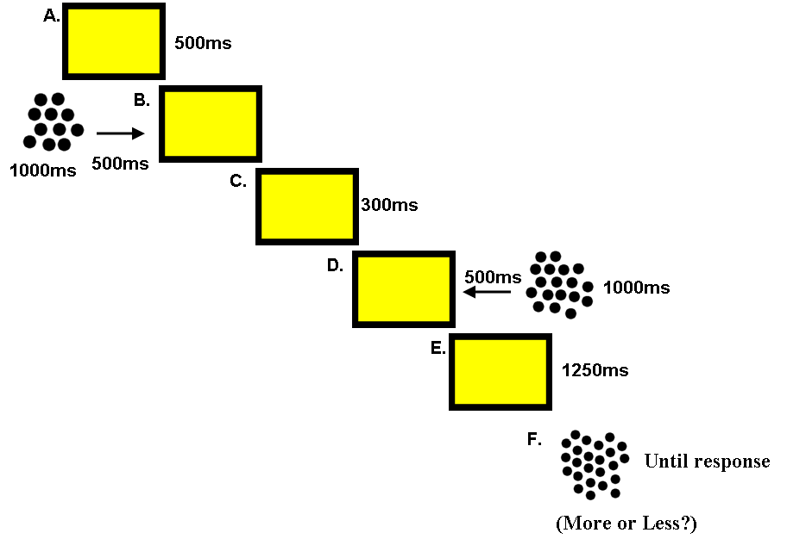
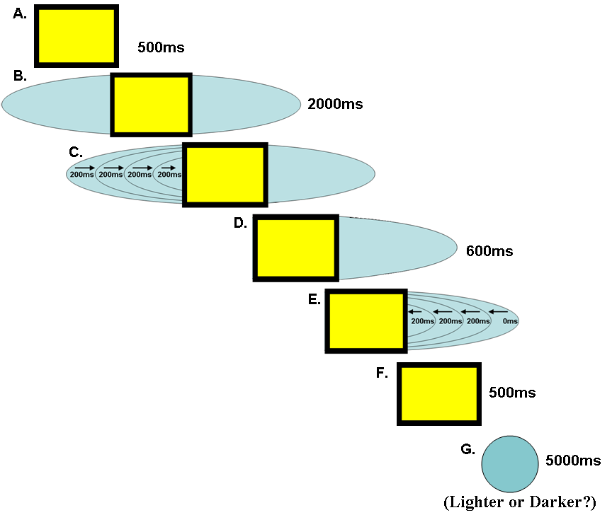
Research Design
Experiment 1- Phase 1
Experimental Group
Sequence of experimental activities
Control Group
8 practice trials
training with 50 trials (25 7:4, 25 7:5)
20 symbolic addition problems on paper
Re-training 10 trials
20 symbolic addition problems on paper
Numerical Acuity task
8 practice trials
training with 50 trials (25 7:4, 25 7:5)
20 symbolic addition problems on paper
Re-training 10 trials
20 symbolic addition problems on paper
Numerical Acuity task
Non-symbolic approximate addition task
Brightness- Comparison task
Notes:
I will show u in next slides how this task looks like

Slide 44
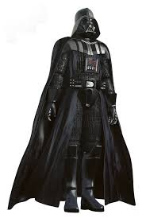
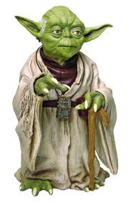
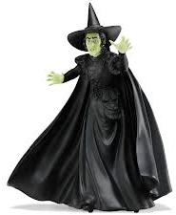
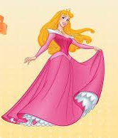
Instruction
Gameplay for training conditions
Context of a game where either
a good cartoon character surreptitiously added more dots (or made the display lighter, or made the line segment taller)
Or
a bad cartoon character surreptitiously stole items (or made the display darker or made the line segment shorter) from behind the occluder, resulting in a final set with more or less numerous (or bright or tall) than the expected outcome.
Bad Cartoon | Good Cartoon
Darth Vader
Yoda
Witch
Princess

Slide 45
Experiment.1
Exact symbolic addition problems 4 sets ( each.10 problems)

Slide 46
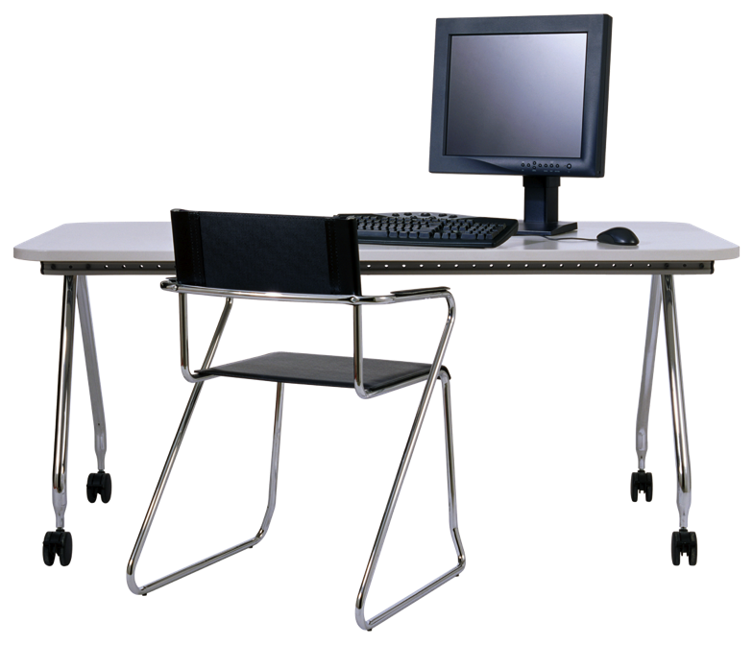
Method
Participants = 83
N=48 first grade, Age 6-7 ?, Quasi randomly assigned to counter balance age and gender : Greater Boston area of Massachusetts, America.
Non-symbolic approximate addition (11 girls, 13 boys, M= 6 years, 311 days)
Brightness comparison (11 girls, 13 boys, M = 6 years, 332 days)
Materials/ Apparatus
Laptop-keyboard
E-prime software (Psychological Software Tools, Pittsburgh, PA) for animated training condition and recording reaction time and accuracy
Paper and pencil, Stopwatch
Camcorder for video recording of all participants

Slide 47
Experimenter
The experimenter was not blind to condition, as she had to instruct children on the introductory trials and continually monitor progress.
Location
Experiments were conducted in a noise free room at lab for developmental studies at Harvard University. Children –recruited through phone, email.

Slide 48
Results
Experiment.1
Age
t-test results comparing groups on age
 | Non-symbolic Approximate addition M (SD) | Brightness comparison M (SD) | t | d
Age | 2501.50 days (73.48) | 2522.13 days (94.27) | .845 | 46
Note: p = .402
Weber Fraction (w*)
t-test results comparing groups on Weber Fraction
 | Non-symbolic Approximate addition M (SD) | Brightness comparison M (SD) | t | d
w | .17 (.11) | .17 (.08) | .003 | 46
Note: p = .998
*Weber fraction was calculated as in Halberda, Mazzocco & Feigenson, 2008.

Slide 49
Experiment.1
*
Notes:
Add analysis of covariates just to show that difference in training task was not cause of dif

Slide 50
Experiment.1
One potential explanation is that both the non-symbolic approximate addition training task and the exact symbolic addition test task engage a common cognitive mechanism for addition, whereas the brightness comparison task does not?
On the other hand, it may be that the approximate number system itself, rather than the addition process, plays a functional role in exact, symbolic math?
If the mechanism of enhancement on math problems is prior engagement of cognitive mechanisms for addition, then that act of adding itself, regardless of whether the addition is performed over numbers or not, should enhance performance on exact symbolic math?
Notes:
If the mechanism of enhancement on test problems is prior engagement of cognitive mechanisms for addition, then that act of adding itself, regardless of whether the addition is performed over numbers or not, should enhance performance on exact symbolic math.

Slide 51
Objective of the study (Experiment.2)
Does engagement of the approximate number system enhance subsequent cognitive performance more generally (motivational or reasoning) or is the effect specific to the domain of mathematics?
to investigate whether practicing non-symbolic numerical addition could yield benefits in accuracy as well as speed?
A new set of harder exact symbolic addition test problems and an equally difficult test sentence completion task was developed in an attempt to generate more variability in accuracy .
If the enhancement effect is specific to mathematics, then training on the non-symbolic approximate addition task should only enhance performance on the symbolic arithmetic problems and not on the sentence completion problems.
Notes:
On the other hand, if more general motivational or reasoning factors are driving the enhancement, improved performance should be observed on both the symbolic math problems and the sentence completion problems in the group of children performing the approximate addition training but not in children performing a control training task (brightness control.

Slide 52
Research Design
Experiment 2- Phase 1
Experimental Group
Sequence of experimental activities
Control Group
8 practice trials
training with 50 trials (25 7:4, 25 7:5)
20 symbolic addition problems on paper
Re-training 10 trials
20 sentences completion problems on paper
Numerical Acuity task
8 practice trials
training with 50 trials (25 7:4, 25 7:5)
20 symbolic addition problems on paper
(counter balanced the order of math and sentences problems)
Re-training 10 trials
20 sentences completion problems on paper
Numerical Acuity task
Non-symbolic approximate addition task
Brightness- Comparison task
52
11/5/2020 2:42 PM

Slide 53
Exact symbolic addition 2 sets each comprising 10 problems
Sentences with blanks 2 sets, each comprising 10 problems
Experiment.2

Slide 54
Experiment.2
S1i. Sentence completion problem sets 1-2
Set 1. Please fill in the blanks by completing the one word
Planes land at the A___________.
Bees live together in a H____________.
A square has four corners and four S_____________
We keep our pants around our waist with a B_____________.
The birds all gathered together in a single F__________.
To enter a movie theater you first need to purchase a T________.
To draw straight lines you need a pencil and a R____________.
The Porcupine has defensive Q____________.
Poisonous mushrooms are bad to eat because they are T_______.
Lavender is a shade of P_______________.
Set 2. Please fill in the blanks by completing the one word
A blizzard is a very large snow S____________.
Animals will starve if they cannot find any F____________.
Pirates use maps to look for buried T____________.
If an animal has a fatal disease, it will D___________.
No matter how hard Jenny tried to find her missing lunch box, it was impossible to L____________.
A chameleon uses camouflage to blend in with its environment by changing its skin C___________.
Jimmy limped because he had injured his F___________.
Animals that are raised in captivity live in C_____________.
The brave soldier who never won battles and never gave up was V____________.
Amy felt so fatigued that she went to S____________.

Slide 55
Age
Experiment.2
t-test results comparing groups on age
 | Non-symbolic Approximate addition M (SD) | Brightness comparison M (SD) | t | d
Age | 2759 days (87.77) | 2751day (100) | -.299 | 46
Note: p = .766
Weber Fraction (w)
t-test results comparing groups on Weber Fraction
 | Non-symbolic Approximate addition M (SD) | Brightness comparison M (SD) | t | d
w | .1707 ( .0799) | .1719 (.0674) | .056 | 46
Note: p = .955

Slide 56
Results
Experiment.2
*
*
*
Brightness comparison group were faster (F (1, 46) = 45.911, p < .001, η² = .500) and more accurate (F (1, 46) = 46.054, p < .001, η² = .500) than approximate addition training group.
\

Slide 57
Objectives (Experiment.3)
Whether the enhancement of exact symbolic arithmetic was due to performance of arithmetic over numerical representations or engagement of the numerical representations more generally
To determine whether differences in difficulty between training tasks, the process of addition, and/or the engagement of the approximate number system drove the effects in Experiment 1
Whether a task involving addition, but not numerical representation, also facilitates children's performance of symbolic arithmetic, when it is designed to be equal in difficulty( in terms of reaction time and accuracy) to the another non-symbolic; comparison task
Notes:
To distinguish between these explanations, we devised a training task involving approximate numerical comparison and compared performance on the same exact symbolic arithmetic problems of those trained on the new numerical comparison training task to the previous results

Slide 58
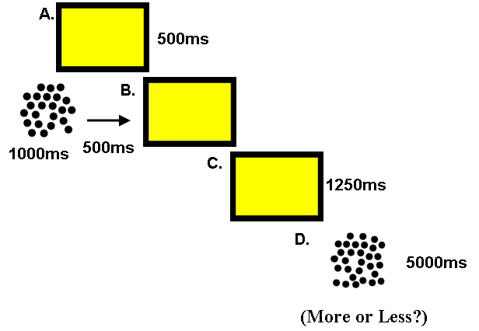
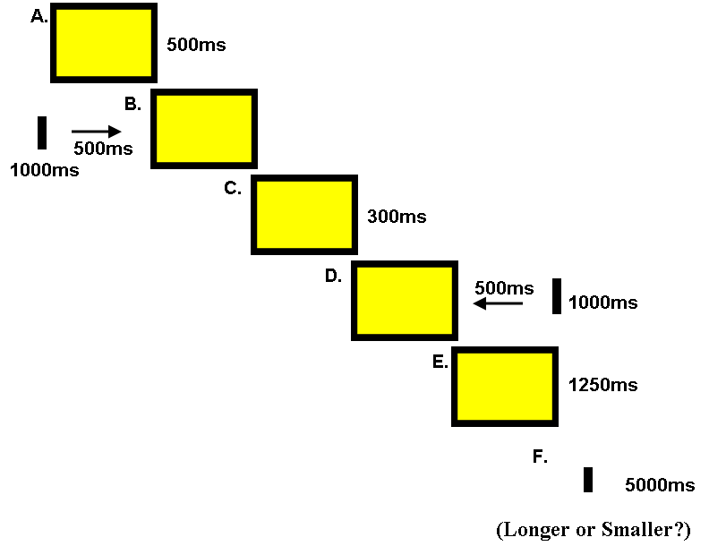
Research Design
Experiment 3- Phase 1
Experimental Group
Sequence of experimental activities
Control Group
8 practice trials
training with 50 trials (25 7:4, 25 7:5)
20 symbolic addition problems on paper
Re-training 10 trials
20 symbolic addition problems on paper
Numerical Acuity task
8 practice trials
training with 50 trials (25 7:4, 25 7:5)
20 symbolic addition problems on paper
Re-training 10 trials
20 symbolic addition problems on paper
Numerical Acuity task
Non-symbolic approximate comparison task
Line addition task
58
11/5/2020 2:42 PM

Slide 59
Experiment.3
Age
t-test results comparing groups on age
 | Non-symbolic Approximate comparison M (SD) | Line length addition M (SD) | t | d
Age | 2545 days, (67 days) | 2501days (77 days) | -2.12 | 46
Note: p <.05
Weber Fraction (w)
t-test results comparing groups on Weber Fraction
 | Non-symbolic Approximate comparison M (SD) | Line length addition M (SD) | t | d
w | M = .18, (.08) | M = .21, (.12) | .970 | 46
Note: p = .337

Slide 60
Results
Experiment.3
*

Slide 61
Experiments replicated in Pakistan in school setting
Replication and to explore would it be specific to the participants from technologically advance set up or from different culture as well?
No training studies conducted on ANS role in symbolic math and number line placement in Pakistan

Slide 62
Research Design
Experiment 1
Experimental Group
Control Group
8 practice trials
training with 50 trials (25 7:4, 25 7:5)
20 symbolic addition problems on paper
Re-training 10 trials
20 symbolic addition problems on paper
Numerical Acuity task
8 practice trials
training with 50 trials (25 7:4, 25 7:5)
20 symbolic addition problems on paper
Re-training 10 trials
20 symbolic addition problems on paper
Numerical Acuity task
Non-symbolic approximate addition task
Line addition task
Notes:
we kept design,tasks similiar to see whether training would benefit children in pakistan?

Slide 63
Method
Participants
N=48, 6-7 years old first grade children quasi randomly assigned to counter balance age and gender from Islamabad Public school Pakistan.
Non-symbolic approximate addition 24 (11 girls,13 boys, mean age= 6 years 172 days
Line length addition 24 (11 girls, 13 boys mean age= 6 years, 183 days).

Slide 64
Age
t-test results comparing groups on age
 | Non-symbolic Approximate addition M (SD) | Line length addition M (SD) | t | d
Age | 2362.21 (86.90) days | 2373.67 (86.68) days | .457 | 46
p = .650
Weber Fraction (w)
t-test results comparing groups on Weber Fraction
 | Non-symbolic Approximate addition M (SD) | Line length addition M (SD) | t | d
w | .19 (.09) | .19 (.08) | -.031 | 46
p = .975

Slide 65
Results

Slide 66
Accuracy
Repeated measures ANOVA of condition (Non-symbolic addition vs. Line addition) and difficulty (1, 2, 3, 4) on symbolic addition accuracy
Effect | df | F | η² | p
Condition | 1,46 | 2.702 | .055 | =.107
Difficulty | 3,138 | 122.577 | .727 | <.000
Condition* Difficulty | 3,138 | .315 | .007 | =.814
Reaction time
Repeated measures ANOVA of condition (Non-symbolic addition vs. Line addition) and difficulty (1, 2, 3, 4) on symbolic addition reaction time
Effect | df | F | η² | p
Condition | 1,46 | 5.418 | .105 | <.05
Difficulty | 3, 138 | 70.372 | .605 | <.000
Condition* Difficulty | 3,138 | 3.190 | .065 | <.05
*critical main effect of Training Condition remained after accounting for training reaction time as a covariate F (1, 45)= 8.380, p <. 05, η²= .157.
Notes:
experimental manipulation of training condition had a significant effect on the time it took to participants to complete exact symbolic addition problems even after accounting for differences in reaction time and accuracy on the immediately previous training task.

Slide 67
Experiment 2
Objectives of the study
To explore whether non–symbolic addition task might enhance performance on other symbolic task like symbolic number task such as number line placement task.
Further more it was to explore whether non-symbolic addition leads to more linear number placements because ANS representations are ratio limited.
Notes:
Results of experiment 2 of phase 1 (data collected from USA), has shown that non-symbolic addition practices enhance symbolic addition but not a non-mathematical task, like reading. So

Slide 68
Research Design
Experiment 2
Experimental Group
2 Control Groups
8 practice trials
training with 50 trials
(25 of 7:4, 25 of 7:5)
24 number line placement
problems on paper (2 stacks)
Re-training 10 trials
24 number line placement
problems on paper (2 stacks)
Numerical Acuity task
8 practice trials
training with 50 trials
(25 of 7:4, 25 of 7:5)
24 number line placement problems on paper (2 stacks)
Re-training 10 trials
24 number line placement problems on paper (2 stacks)
Numerical Acuity task
8 practice trials
training with 50 trials
(25 of 7:4, 25 of 7:5)
24 number line placement problems on paper (2 stacks)
Re-training 10 trials
24 number line placement problems on paper (2 stacks)
Numerical Acuity task
Non-symbolic approximate addition
Line addition
Brightness- Comparison

Slide 69
Method
Stimuli-tasks (same)
Participants
Non-symbolic approximate addition (13 boys 11 girls, M.age 6 years,162.25 days),
line length addition (13 boys 11 girls, Mean age = 6 years, 138.9 days)
Brightness comparison (13 boys and 11 girls, Mean age = 6 years, 168.33 days)

Slide 70
Number line placement task (Siegler & Booth, 2004), Instructions (Booth & Siegler, 2006). Mental number line is analogous to an actual number line and therefor is a continuous measure, it is assume to have left –right orientation with smaller numbers represented on the left and larger number on the right.
Arabic numerals between 1-99 were used to mark on the 23 cm long line
24 Arabic numbers problems and each problem was presented twice (in total 48),
3, 4, 6, 8, 12, 17, 21, 23, 25, 29, 33, 39, 43, 48, 52, 57, 61, 64, 72, 79, 81, 84, 90,96.
Mean % Absolute Error and reaction time
Children’s estimation accuracy was calculated as percentage of absolute error (PE) using following formula (Siegler & Booth, 2004).
PE = | estimate – target number | ×100
Scales of estimate
Where would 79 go?
0
100
23 cm

Slide 71
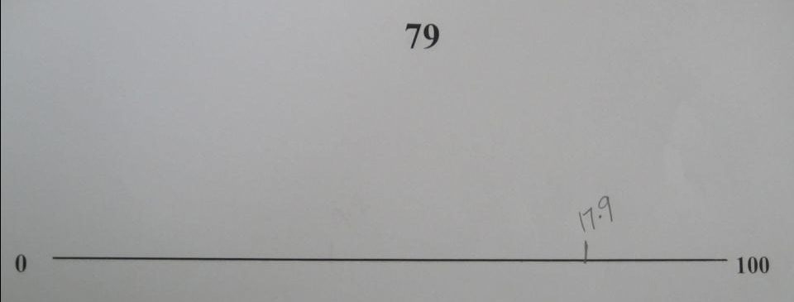
Original cm 18.17=marked number 77.82
% Error = 1.173913043

Slide 72
Age
t-test results comparing groups on age
 | Non-symbolic Approximate addition M (SD) | Brightness comparison M (SD) | t | d
Age | M=2352.25 (102.67) days | M= 2358.33 (99.66) days | -.208 | 46
p = .836
 | Non-symbolic Approximate addition M (SD) | Line length addition M (SD) | t | d
Age |  | 2328.92 (81.06) days | .874 | 46
p = .387
Weber Fraction (w)
t-test results comparing groups on Weber Fraction
 | Non-symbolic Approximate addition M (SD) | Brightness comparison M (SD) | t | d
w | .19 (.14) | .20 (.10) | -.381 | 46
p = .705
 | Non-symbolic Approximate addition M (SD) | Line length addition M (SD) | t | d
w |  | .23 (.09) | -1.192 | 46
p = .240

Slide 73
Results
*

Slide 74
Results
No significant differences observed in performance between the numerical comparison and the numerical addition performance
Enhancing effects of approximate number representations are limited to the domain of symbolic mathematics
Further questions
the developmental origins of the relationship between the ANS and symbolic number remain unclear
symmetry or asymmetry of the causal relationship
depth and temporal extent of the effects of ANS activation on symbolic number processing
momentary or enduring
Notes:
experiments provide evidence that brief practice on a non-symbolic approximate numerical task enhances the performance o 6-7 year old children on a subsequent test of exact, symbolic arithmetic.
How are the findings related to the conceptual framework from the literature?

Slide 75
Aknowledgement

Slide 76
Questions?

