Slide 1
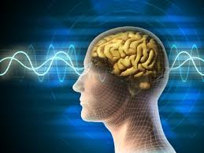
ABNORMAL PSYCHOLOGY IN THE CONTEXT OF PAKISTAN
Dr. Saeeda Khanum
02 November 2020

Slide 2
Abnormal Psychology in the context of Pakistan
Abnormal Psychology in Pakistan
How and why I chose psychology?
Diagnosis, etiology and treatment of mental disorders in Pakistan
Indigenous ways of handelling psychological problems
Variations in seeking treatment
Social and cultural factors
Religious factors
Roadblocks in the way of seeking professional help
Role of stigma, labeling, streotypes etc..
Current status of abnormal psychology resources in Pakistan
Governig body, Knowledge, book, resources status etc…
Future of Abnormal Psychology in Pakistan
Q& A

Slide 3
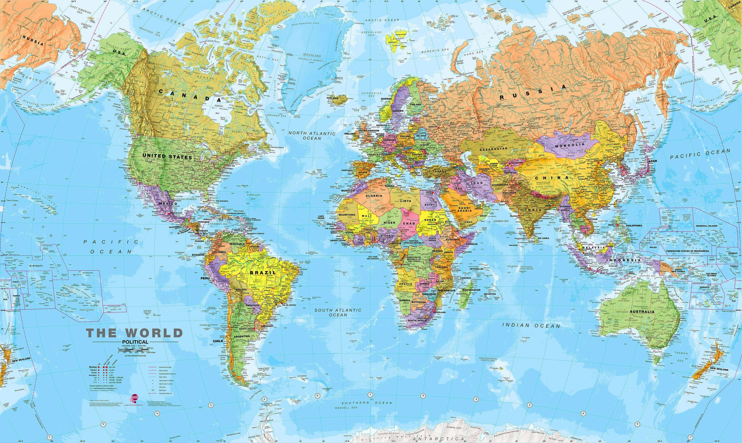
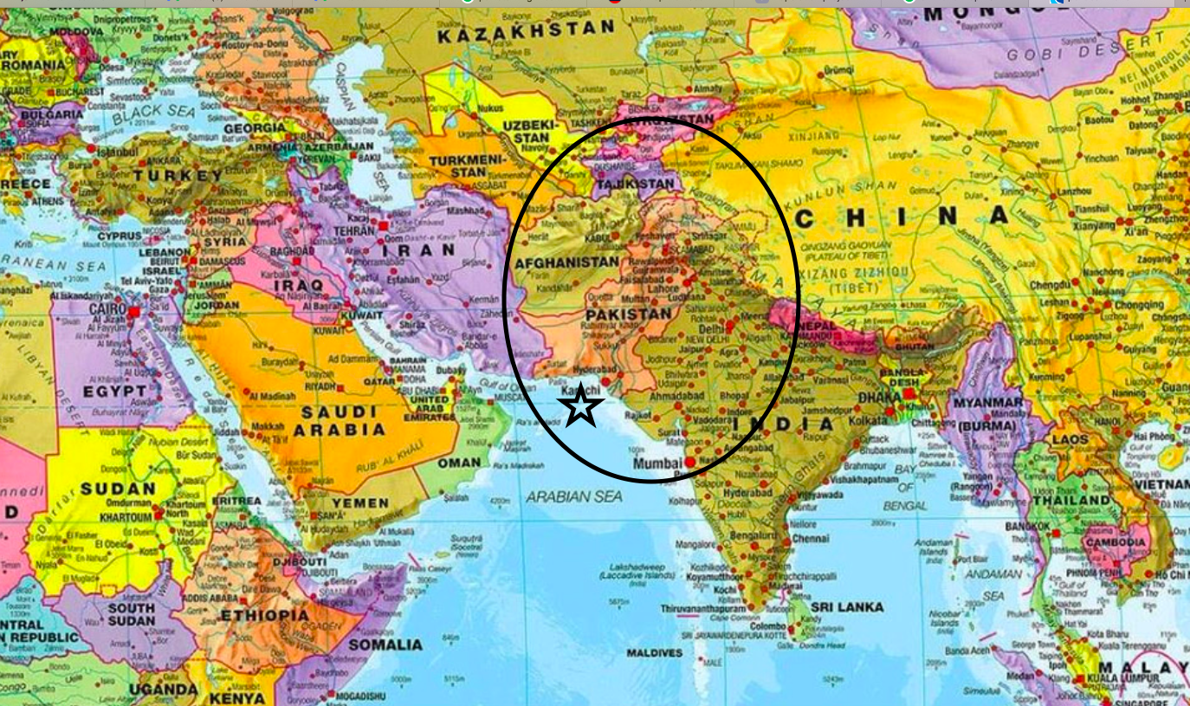

Slide 4
INDICATORS OF ABNORMALITY
SUBJECTIVE DISTRESS
MALADAPTIVENESS
STATISTICAL DEVIANCY
SOCIAL DISCOMFORT
DANGEROUSNESS
IRRATIONALITY OR UNPREDICTABILITY

Slide 5
Abnormal Psychology in Pakistan
2 hospitals in 1947
Perception and awareness: less understanding of the mental health problems
Terms (pagal, mad)
Books, knowledge, models and reasearch (all western)
No efficacy or evidence based indignous database at national level
Assesment issues as no indigenous rigoursely tested assesmented methods
No central governing body for all professional providing help for various professional, subsequently
People with mental disorders more vulnerable
Ethics
Mistrust overall about professional

Slide 6
MEDICAL OR PHYSICAL PROBLEMS
SPIRITUAL OR SUPERNATURAL
OUTCOME OF RELIGIOUS PROBLEMS
OUTCOME OF PSYCHOLOGICAL PROBLEMS
CAUSES OF MENTAL DISORDERS
Notes:
At the time of partition in 1947, northern India, which formed the current Pakistan, had only two; one in Lahore (established in 1840) and the other in Hyderabad (established in 1865).
there was a total of 2000 beds for a population of more than 100 million. The asylums were in a neglected condition, there were few qualified psychiatrists, and patients were managed by minimally trained doctors. These hospitals were called ‘Mad Houses’ in the local languages and patients could be admitted in chains.
There was very little change for the first 20 years of Pakistan’s existence.
unregulated practices based on concoctions of traditional influences.
participants typically used expression like ‘weakness of brain or illness of brain’, ‘illness of suffocation’, ‘illness of poor sleep’ or ‘tension’ as the cause of their problem. When asked if they heard or knew anything about ‘Depression’, they answered in negative.

Slide 7
Medical or Physical problems
It can be true scientifically like genetics explanation or at the neurotransmitters level
Acceptance of tendency to somatisation and avoidance of acceptance of psychological and emotional difficulties
A person with physical illness vs. mental- care and support varies

Slide 8
SPIRITUAL OR SUPERNATURAL
Saya’, ‘Jinn possession’(ghost ) and ‘Churail’(witchcraft )

Slide 9
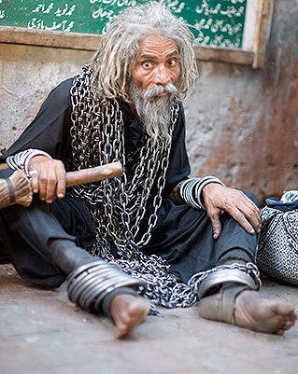
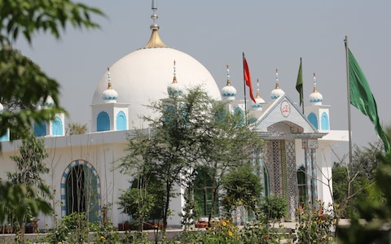
Stay on shrines of spriritual deceased people

Slide 10
Treatment expectation
vary according the cause of disorder
Suhail et al. (2019) reported that in their study population, more people believed that general practitioner’s (23.76%), psychologists (23.92%) and psychiatrists (20.73%) were the right people to consult for these problems.
Compared to the above, there were also a lesser proportion who considered Hakims/Homeopathy Practitioners (4.22%), Magical Healers (13.11%) and Religious Healers (13.54%) as the appropriate people to contact
Herbal medicine
Black magic

Slide 11
Roadblocks for seeking professional help
Cultural constructs ‘izzat’
Stigma affecting both genders
The treatment choices are affected by the explanatory model of the illness as some people tend to prefer medical practitioners or psychiatrists to receive treatment
Others prefer other kind of non-licenced practitioners including spiritual/faith healers, hakims and so on.
Culture: individualistic vs collectivistic
Need to seek approval from many members of family mainly men of the house in some areas
Legitimacy of a mental disorder

Slide 12
Western psychology and indigounous psychology scope for Mental health problems in pakistan
Issues
Ethics, authenticity of professional, record keeping and maintaing
Privacy issues
Differences in population charachteristics, culture and delivery with effectiveness
Lack of trained professionals
Few things that are norm in Pakistan might not be in western world (male dominanace, decision making etc., submissiveness owmen)

Slide 13
Following DSM word to word - malpractice without certification and supervision
Mushroom growth of practioners without any permission or monitoring
Resulting in harmful ways of handling psychological problems

Slide 14
STRONG BELLIEF IN MEDICATION INSTEAD OF COUNSELING AND THERAPY
Drug dependence or not completing the course of treatment
Side effects
Easy access to all kind of drugs- give rise to further problems
Self medication

Slide 15
Type of professionals
PSYCHIATRISTS
(MBBS, TRAINING , CERTIFICATIONS)
PSYCHOLOGISTS,
COUNSELORS
(TRAINED CERTIFIED)
COUNSELORS/PSYCHOLOGISTS
(MASTERS DEGREE WITHOUT PROFESSIONAL TRAINING AND UNDER PROPER SUPERVISION)

Slide 16
COMMUNITY BASED MODELS
Community-based model e.G., Institute of psychiatry, rawalpindi, in collaboration with the WHO
NGO’s

Slide 17
Other healers
Religious healers
‘evil eye’, bad wishes from others, and machinations of sorcery.
The solution would involve religious talismans and reciting holy verses
Spiritual healers
Khalifas and gadinashins—‘the person who sits on the master’s or teacher’s seat’ and commonly applied to people who have inherited the craft of healing. Magic and sorcery, as well as spiritual power associated with the saints, is used to ‘heal’ patients.
Hakims, adherents of ayurvedic or greek medicine,
‘alternative’ healers include homeopaths, practitioners of chinese herbal medicine and acupuncturists.

Slide 18
Mental Health Challenges in Pakistan
Pakistan, a developing country
Risk factors for include gender, low level of education, financial difficulty and relationship problems, sociopolitical instability, economic uncertainty, violence, natural disasters
Earthquake, floods causing population displacement, PTSD
Afghan refugees, violence
Unemployment
Population growth
In the current context of conflict, natural disaster and fragile health systems, the most vulnerable groups are women and children.
There are no reliable estimates for prevalence rates given the lack proper reporting and data monitoring
During recent years, many epidemiological studies , systematic review of prevalence

Slide 19
MODERN FACILITIES
Hospital units all over Pakistan include psychiatry and clinical psychologists but shortage of mental health specialists is still a problem,
Many small psychiatric hospitals have been opened throughout the country, privately run in most cases by psychiatrists and allied mental health professionals.
Lately there has been a significant increase in self-help techniques described through media and professional services online

Slide 20
Recent efforts
Recent research efforts shows great potential for primary care and community-based services
Resources (indigenous)
number of trained mental health professionals has increased
Training and professional qualification in clinical psychology from foreign countries
Need for establishing and monitoring mental health issues at Govt level is required

Slide 21
Aknowledgement

Slide 22
Questions/Comments

