Slide 1




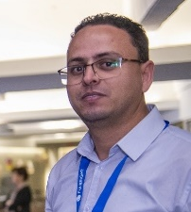



Tunisia Today—Culture, Traditions, and People
Manef BOUROGAOUI
Fulbright Visiting Scholar
Arlington, VA, USA, November 17 - 2020

Slide 2
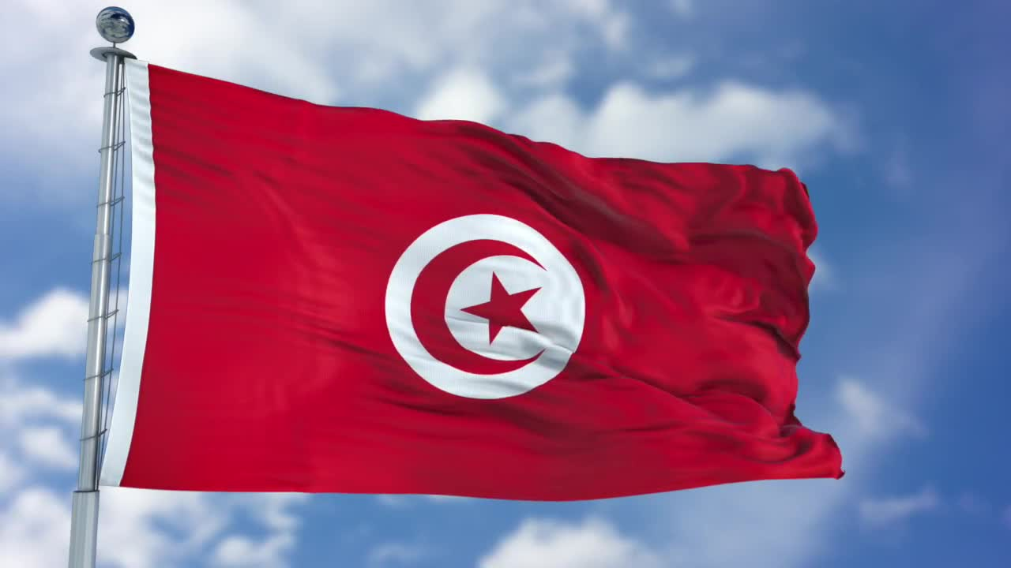
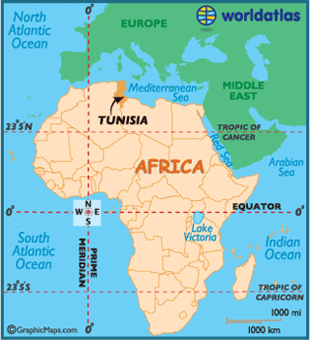
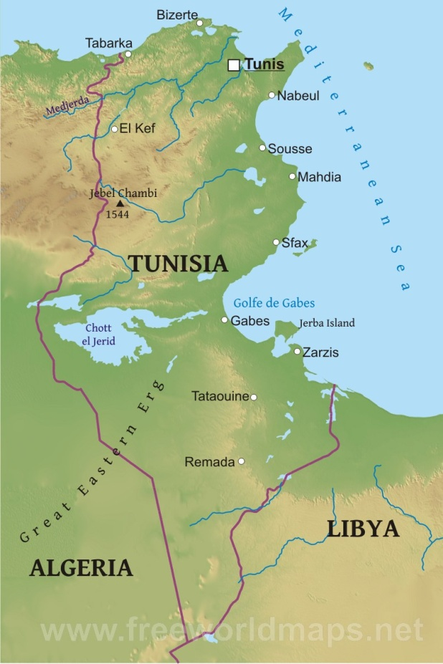

Country Geographic Position
Tunisia
Tunis
1/17

Slide 3

Information
تونس
Tunisia
Tunisie
Capital: Tunis
Official Language: Arabic
Spoken Languages: Tunisian, French, English
Population: 11,722,038
Area: 63.17 sq mi
Order
Liberty
Justice
2/17

Slide 4
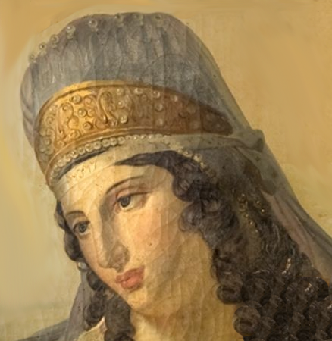
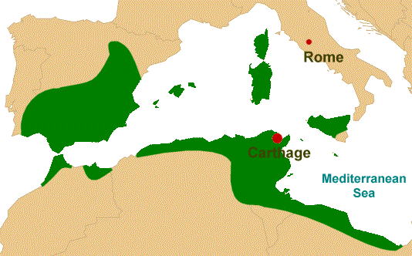
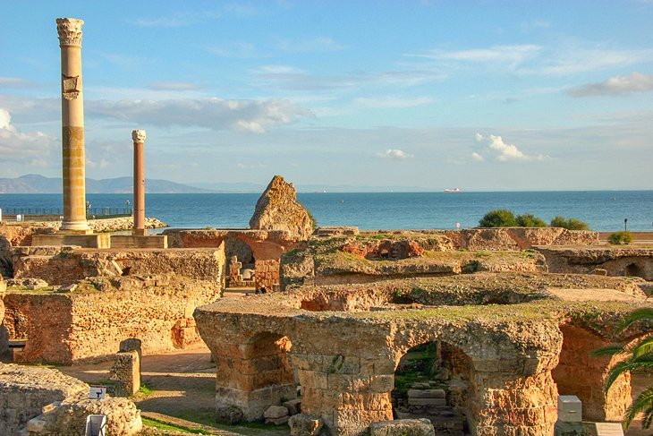
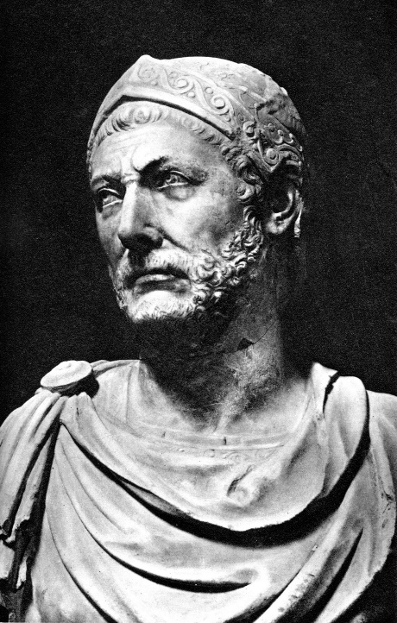
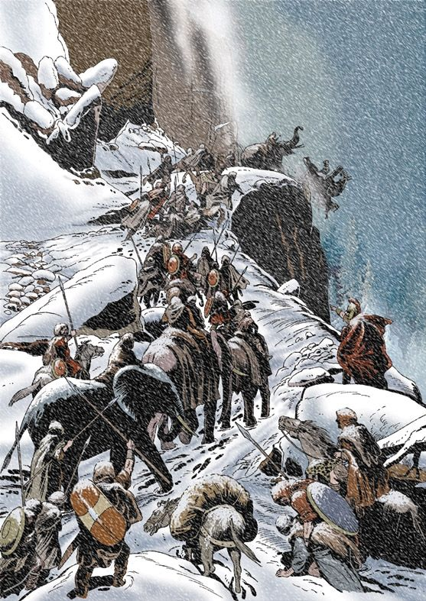
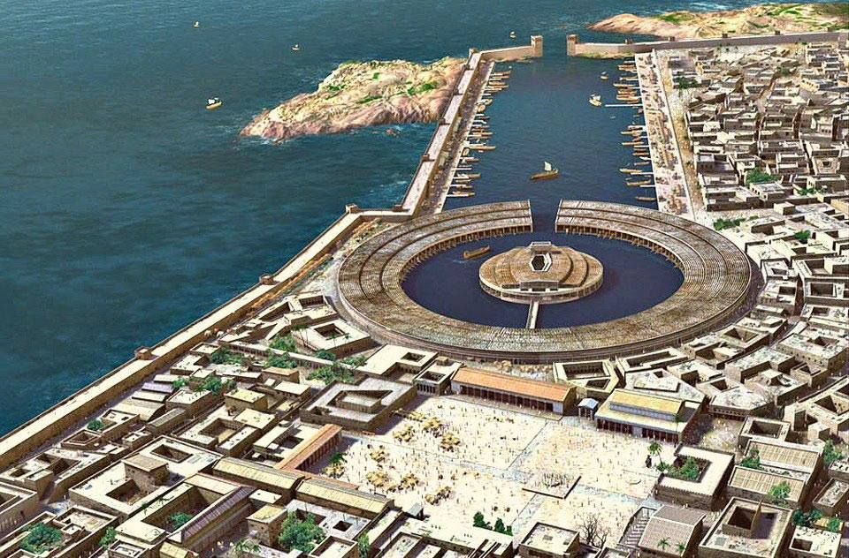
History: Carthage Civilization
Elissa - Dido
Carthage Borders
The Ruins of Ancient Carthage
814 B.C
The journey of Hannibal through Alps mountains
Hannibal Barca
The Port of Ancient Carthage
3/17

Slide 5
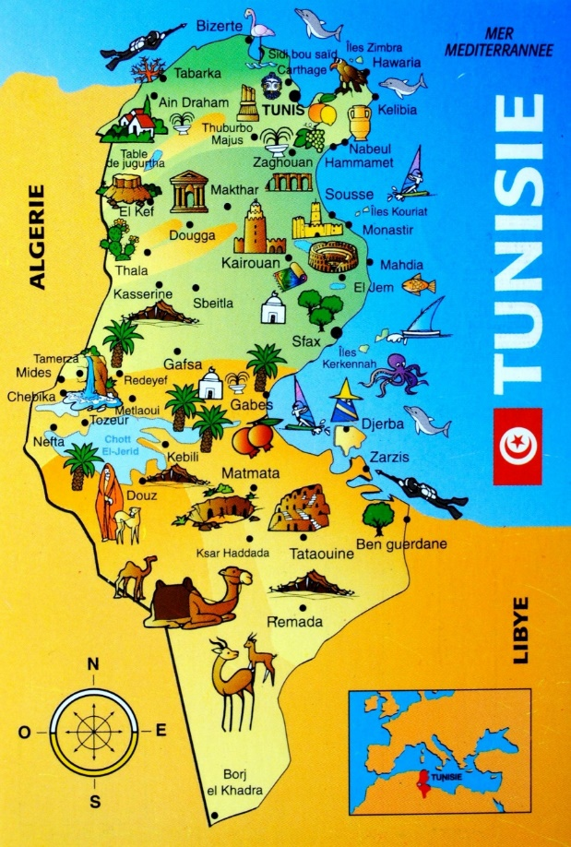
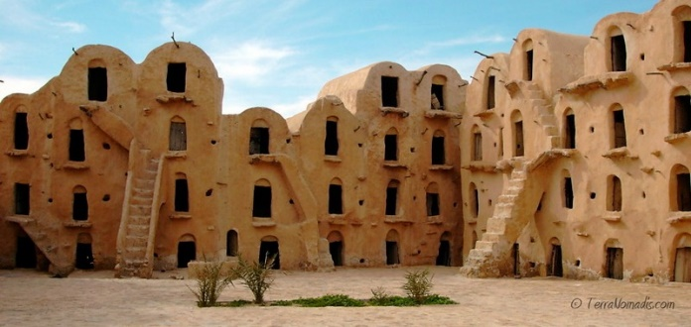
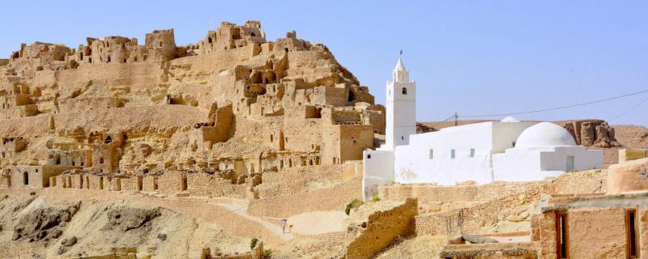
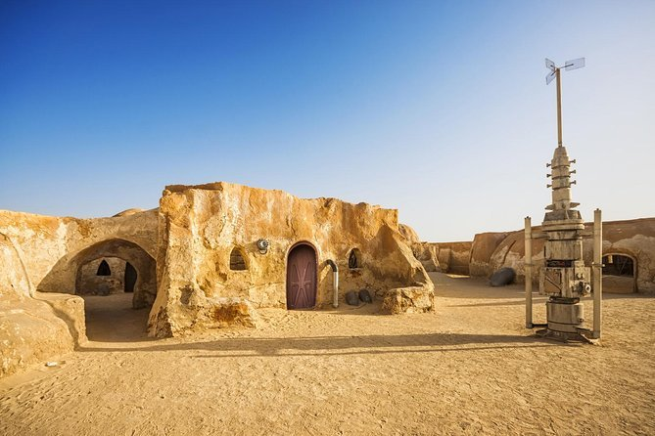
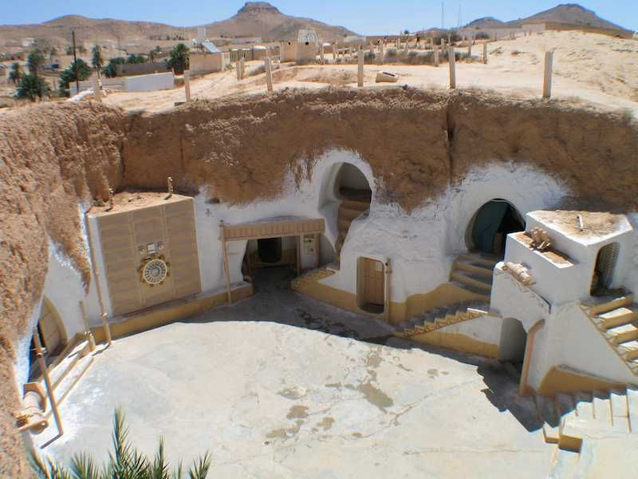
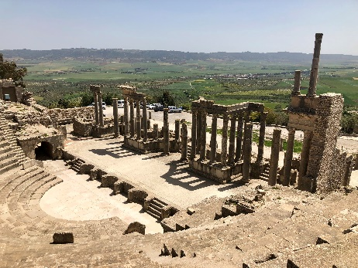
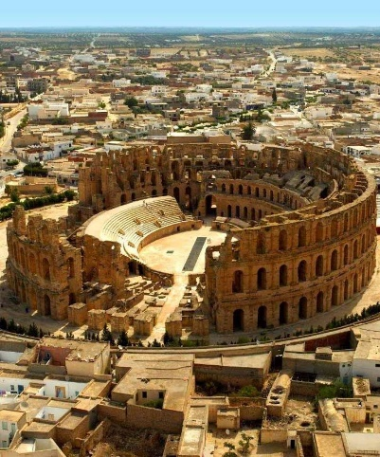
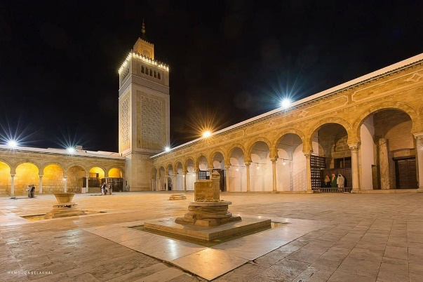
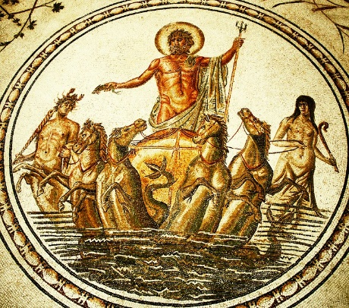
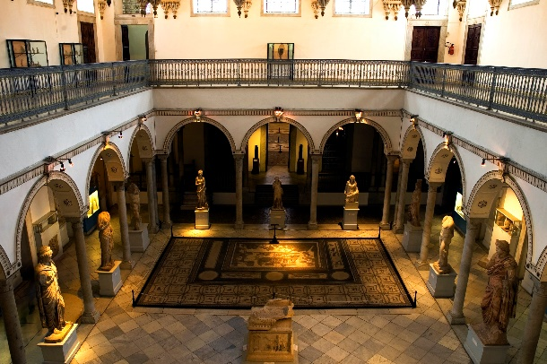
Monuments
Ksour, Tataouine, ‘Star Wars’ movie
Cheneni, Tataouine
‘Star Wars’ movie Site, Tozeur
Matmata, Gabes
Archaeological site of Dougga, Beja
Roman Colosseum, El Djem
Al-Zaytuna Mosque, Tunis
The National Bardo Museum
4/17

Slide 6
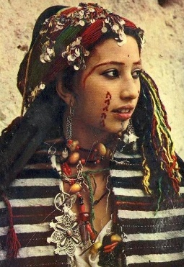
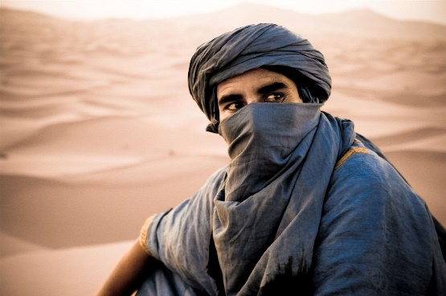
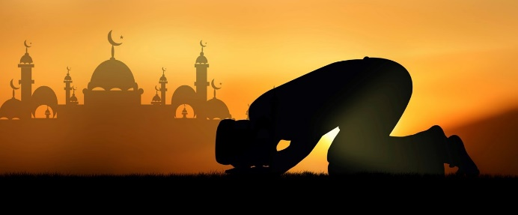
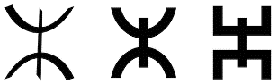
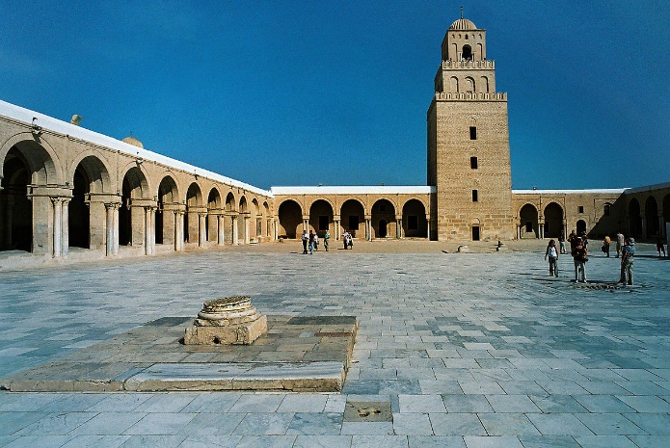
Tunisia’s People: Origine
Origin: Berber (Amazigh)
Religion: Islam 98% of the Population
Amazigh
Ottomans (Turkey)
Arabs
Sub-Saharan Africans
Romans
Phoenicians (Punics)
Jewish
Europeans (French settlers)
5/17

Slide 7
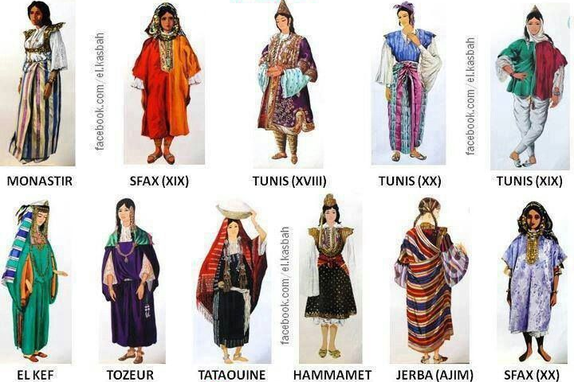
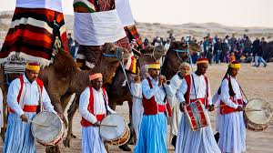
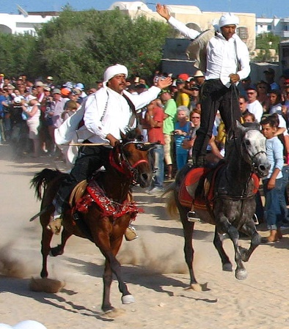
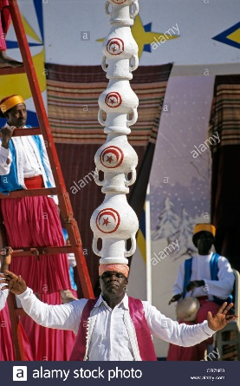
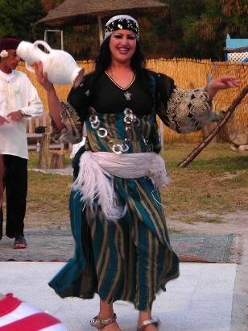
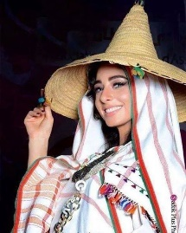
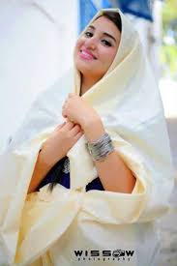
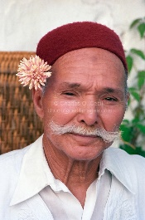
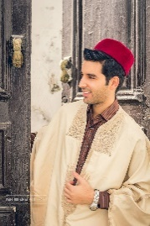
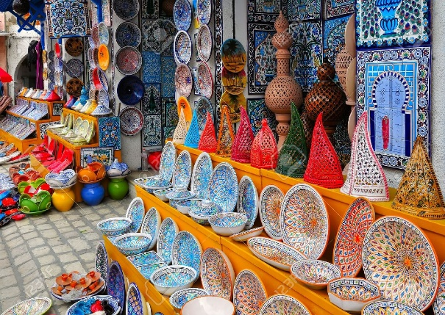
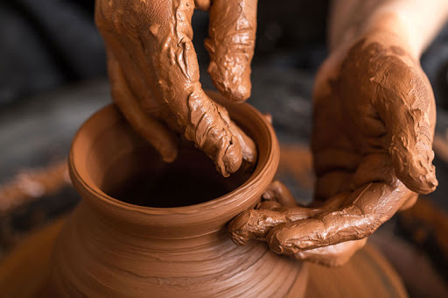
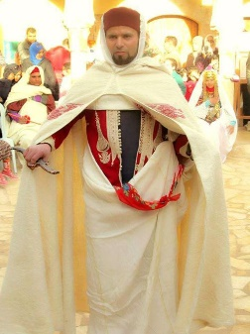
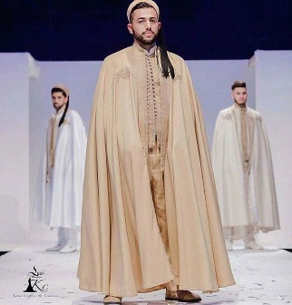

Tunisia’s People: Traditions and Arts
Traditional Clothing
Tunisia Folklore
‘Safsari’
‘Djebba’
Traditional Ceramics
‘Barnous’
Hat ‘Chechia’
6/17

Slide 8
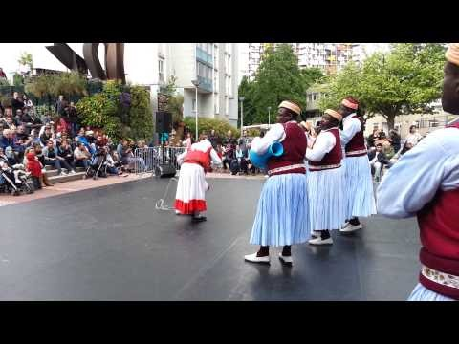
Tunisia’s People: Traditions and Arts
Tunisia Folklore
https://www.youtube.com/watch?v=4Xe6Bmha1PY&feature=youtu.be
7/17

Slide 9
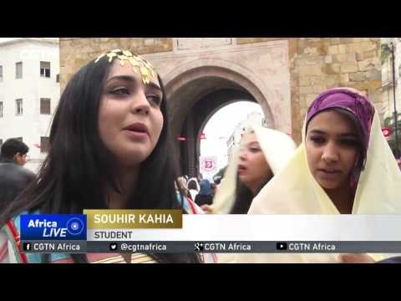
Tunisia’s People: Traditions and Arts
https://www.youtube.com/watch?v=SivLQnjBSkw
8/17

Slide 10
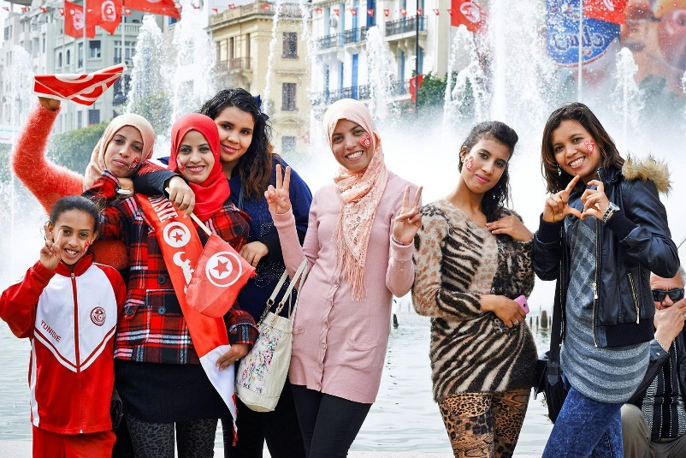
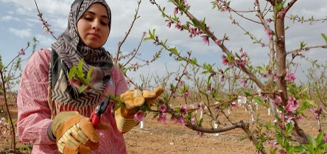
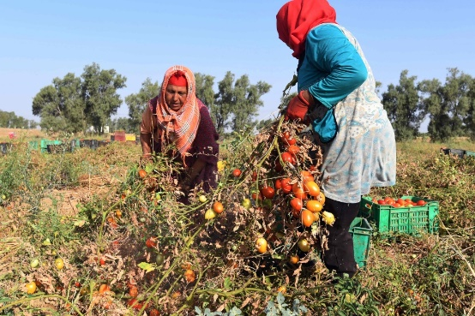


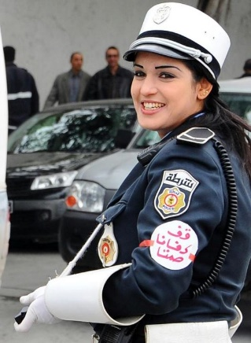
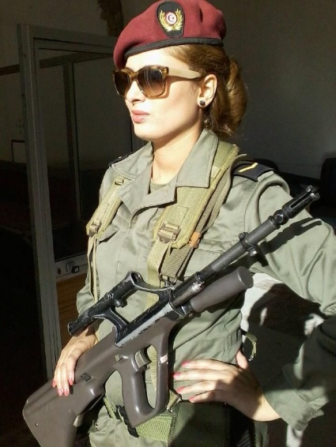
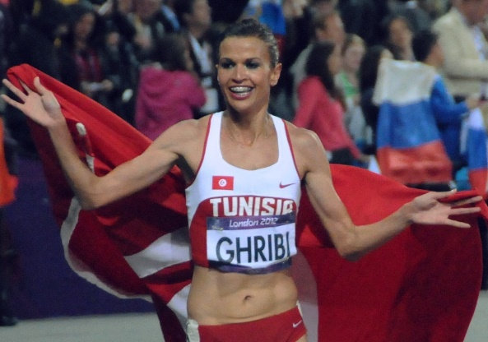

Tunisia’s People: Woman
Agriculture
Politics
Scientific Research
National Security
Sports
Young women represent 59.5% of students enrolled in higher education
9/17

Slide 11
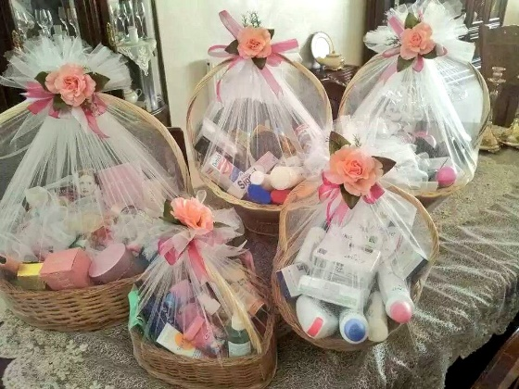
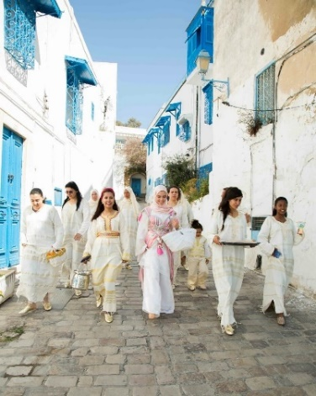
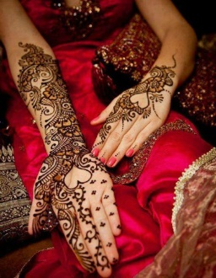
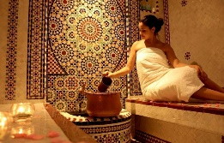






Tunisia’s People: Weddings
7 days and 7 nights to get married
1st Day: Bride’s Trousseau
2nd Day: ‘Hammam’ or Spa and ‘Henna’
3rd Day: ‘Keswa’
5th Day: ‘Outia’
7th Day: Wedding
6th Day: Groom ‘Henna’
4th Day: Prenuptial Agreement Signature
10/17

Slide 12

Tunisia’s People: Weddings
https://www.youtube.com/watch?v=2nyd996xUDQ
11/17

Slide 13










Tunisia’s People: Celebrations
The Holy Month ‘Ramadan’
‘Aid el-Fitr’
‘Al Mawlid’
‘Aid al-Adha’
12/17

Slide 14








Traditional Foods, Gastronomy
Dates
Olive Oil
Harissa
Brik
Lablabi
Couscous
Fricassé
13/17

Slide 15






Attractions
Medina, Tunis
Chebika, Tozeur
Douz, Kebili
Sidi Bou Said, Tunis
‘The Sahara’ or desert, Tozeur
14/17

Slide 16










Attractions
‘Red Lizard’ Train, Seldja, Gafsa
Kairouan
Beaches, Kelibia
Chott el Djerid, Tozeur
Rocky Cliff Beaches, El Haouaria
Forests and Mountains, Ain Draham
Canyon and Oasis, Temerza
15/17

Slide 17











Tunisian Revolution
Jasmine Revolution
Arab Spring
Nobel Prize
16/17

Slide 18

https://www.youtube.com/watch?v=-4KaxCcePTM
17/17

Slide 19





Slide 20
Tunisia Today—Culture, Traditions, and People
Manef BOUROGAOUI
Fulbright Visiting Scholar
Email: manef@vt.edu
Phone: +21654947445
Arlington, VA, USA, November 17 - 2020

