Slide 1
Strategies for Managing Online Classes
Presenter: Helena Taylor
Notes:
Welcome to the workshop called Strategies for Managing Online Classes. My name is Helena Taylor and I will be presenting this workshop.
ONLINE CLASSES GIVE students the flexibility to take their class anytime, anywhere. The trick is staying on top of them. Doing so requires discipline, commitment, and organization—traits any successful student should possess. Unlike their peers in the classroom, who have regular face time with instructors, online students receive no in-person reminder of when papers are due, or tests are scheduled. Throw in everyday distractions typical for an online student—full-time jobs, kids, family activities—and the work can easily pile up.
The big myth is it is easier to go online, because you can do it at your own pace. It is true you do have more flexibility, but it is not any easier … It is harder because you are on your own and you are left to your own devices.

Slide 2

Time Management Strategies for
Online Classes
Plan ahead
Don’t Multitask
Set-up Your Virtual Office
Get Organized
Develop Good Habits
Block Out Distractions
Avoid Procrastination
Create a Balance
Get a Good Night’s Sleep
Notes:
One of the most valuable skills you can have as an online student is effective time management. The better you manage your time, the easier it is to achieve your goals. Everyone has the same 24 hours in a day, meaning, it is not about how much time you have, but how well you can manage it.
This is especially important for online students, who are often working full-time, taking care of family, or juggling other commitments. Without the camaraderie of a class to motivate you or having a set time where you need to be on campus, effective time management is crucial to helping you stay focused.
Effective time management not only helps with your learning but can also make you more productive at work and in your personal life. If you are serious about successfully completing your online degree, it is crucial to find a good system to use.
The following are a few helpful strategies for effective time management for online classes:
(1) Plan Ahead; (2) Don’t Multitask; (3) Set Up Your Virtual Office; (4) Get Organized; (5) Develop Good Habits; (6) Block Out Distractions; (7) Avoid Procrastination; (7) Create a balance; and (8) Get a Good Night’s Sleep.

Slide 3
Plan ahead
Set aside time to focus
Provide plenty of time to space out your assignments
Use a planner to plan your daily and weekly assignments
  Assignments due
  Activities related to your program
  Virtual or in-person office hours with professors and advisors
Notes:
(1) Your hectic schedule, combined with daily distractions, can easily get in the way of finishing tasks. The best online students know how to set aside time to focus. This includes having a consistent time and workspace, tuning off those distractions, and avoiding surfing the internet. (2) Despite the flexibility in being an online student, it is important to have frequent engagement with your studies throughout the week. Provide plenty of time to space out your required readings, assignments, and online discussions. (3) Consider purchasing a calendar and/or planner you can use to plan your daily and weekly assignments, highlighting:
Assignments due, including drafts and final submissions
Activities related to your program, such as study group meetups or on-campus networking events
Virtual or in-person office hours with professors and advisors

Slide 4

Using Planners
Planning takes time; not planning takes more time
Long term schedule
  Fixed commitments (job, church, classes, meetings, etc.)
Intermediate schedule
  Major events (tests, papers due, ball games, etc.)
  Amount of work to be accomplished this week in each subject (reading assignments, etc.)
Review planner regularly
Notes:
Whether it is a hard copy planner or a phone app, using a planner every day is a great way to stay organized. (1) Planning takes time; not planning takes more time. Use a planner to keep track of appointments, due dates, and other important events. (2) Start with a long-term schedule: Fixed Commitments (job, church, classes, meetings, etc.). Write in the must do’s like attending class, meetings, and appointments. Resolve conflicts immediately. As soon as you recognize there will be a problem. It is best resolve it right away. (3) Next an intermediate schedule: Major events (tests, papers due, ball games, etc.). You can use your syllabus for each class to write all the important due dates, deadlines, and exams. Include the amount of work to be accomplished for the week in each subject (reading assignments, etc.). Finally, write in some want to do’s next. Schedule time to exercise, meet with friends, and other things that is important to your well-being. (4) Lastly, it is very important to review your planner regularly – at least once a week.

Slide 5
Sample Schedule for Online Students
Monday | Begin required readings and multimedia
Tuesday | Continue reviewing materials
Wednesday | Post to discussion forum and begin assignments
Thursday | Continue posting and working on assignments
Friday | Read and respond to posts and work on assignments
Saturday | Read and respond to posts and finish assignments
Sunday | Check your work and submit assignments

Slide 6
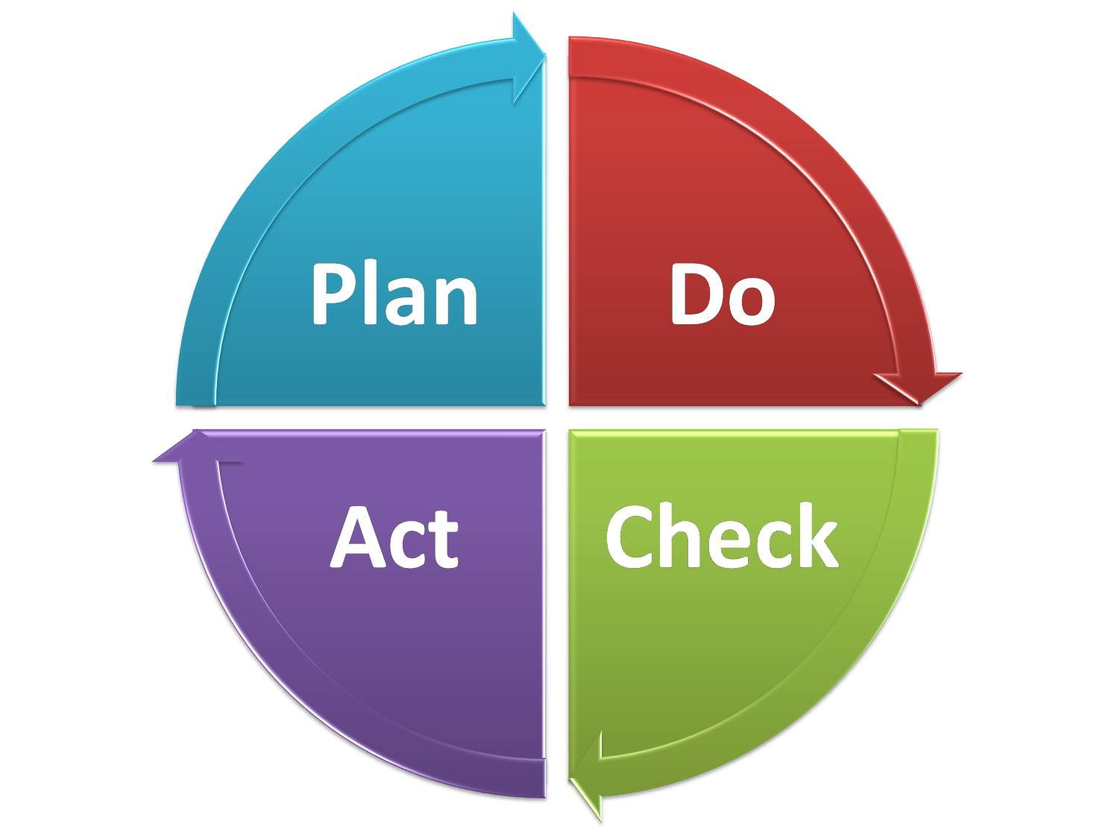
Don’t Multitask
Focus on one assignment at a time
Zero in on the specific task
Prioritize your tasks
Create To-Do Lists
Concentrate on what needs to get done in the present
Notes:
(1) Focus on one assignment at a time (2) Zero in on the specific task at hand, whether that is studying for an exam, reading a textbook, emailing a professor, or participating in an online forum. (3) Prioritize your tasks. Arrange your tasks in order of importance and pay attention to the three or four crucial tasks that require the most effort. (4) If you need help staying focused, then consider creating to-do lists. (5) Lastly, concentrate on what needs to get done in the present and avoid anything too far-off. If it is a small assignment that you do not need to address for several weeks, put it on your calendar to focus on when the deadline is closer.

Slide 7

Using To-Do Lists
Force you to plan
Everything to be accomplished for the day
  Classes, homework assignments, after school activities
Priorities
  Step 1: Understand Each Task Completely
  Step 2: Rank Each Task
  Step 3: Set Deadlines (and Stick to Them)
  Step 4: Be Flexible
Check off each completed item
Notes:
(1) To do lists force you to plan and will prevent you from forgetting all the things you have to do, but they will do nothing to further their completion. To be effective, you must schedule time to get the work done. What gets scheduled usually gets done. What gets postponed usually gets abandoned. The list must be a realistic list. You must know your limitations. (2) Include everything to be accomplished for the day on the list. Make it a habit to spend 5-10 minutes each day on planning your activities with daily to do lists. Start your day with it. Even better, every evening, write a plan for the next day, listing your daily things to do. You can refer to your planner as a starting point. It is very important that you write down all your appointments, commitments, or activities. It will give you a much clearer mind, and will save much of your energy, time, and stress. (3) When making priorities: First, understand each task completely. Second, rank each task, figure out which tasks are urgent and which ones are important. Assignments that are due before others on the list should be ranked higher. Large multi-step projects that will take a significant amount of time to complete can be broken down and numbered based on difficulty and the length of time it will take to complete. Any tasks that need to be finished before moving ahead with others can be numbered accordingly. Once you have flagged the most urgent tasks, you can continue to organize the remaining items on your list. When you are finished, you should have a clear direction for completing your workload. A simple technique is an ABC rating of your priorities. For example, an assignment due the following day should get higher priority than something due next week. Third, set early deadlines and stick to them. Fourth, be flexible with your tasks. (4) After completion of a task take a moment to look at the result and congratulate yourself with the progress.

Slide 8
Set-up Your Virtual Office
Optimal setting
Make sure there’s high-speed internet
Comfortable space
Sit in a comfortable chair
Close out your browser windows, and put your phone away
Make sure you have all required materials
Set up as much as you can ahead of time
Notes:
(1) Whether you study at home or your local café, it is important to work in the optimal setting needed to complete your work. (2) make sure there’s high-speed internet (3) and that you are in a comfortable space with the right lighting, sound, and background. For example, some people prefer to work with headphones on, while others prefer silence or with people quietly chatting in the background. (4) Sit in a comfortable chair, and make sure the lighting is not too dim. (5) Close out your browser windows and put your phone away. (6) Also make sure you have all the required materials, such as textbooks and industry-specific software. (7) Set up as much as you can ahead of time to stay on task with your coursework.

Slide 9
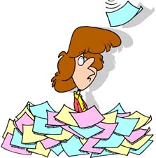
Get Organized
Notebooks/Binders/Files
  Keep important course information in the front of your notebook or binder
  Keep notes and handouts in notebook or binder
  Keep files
Computer Files
  Regularly back up and organize your computer files.
  Create a file for each term, and for each class within the term, on a cloud system like Google drive or Dropbox.
Notes:
Academic success involves more than attending class and completing assignments. To be successful in college, you need to be organized.
(1) Keep important course information like instructor’s email address, office hours, and course syllabus in the front of your notebook or binder. (2) Write your contact information in front of notebook or binder in case it is lost. (3) Your notes and class handouts are your most valuable resource when studying for tests. It is therefore very important that you have a system for keeping these organized. (4) Have a file to store material that might be useful after the class ends. This is especially important for major-related classes.
(1) Regularly back up and organize your computer files. (2) Create a file for each term, and for each class within the term, on a cloud system like Google drive or Dropbox. Or you can use the school’s one drive.

Slide 10
Develop Good Habits
Develop routines
Finding time for class
Create a study plan
Take breaks
Complete class assignments
Avoid distractions
Eliminate clutter
Notes:
(1) Have a morning routine that gets your day off to a good start, and a nighttime routine that includes getting everything ready for the next day before you go to bed. (2) Some classes have set times that students must adhere to, while others have archived lectures that must be viewed by a certain date. Set aside time each week to complete your lectures and take part in any required activities. (3) Know what time of day you study best and create a study plan that works for you. Schedule study time when you are most alert. If you are an evening person, do homework every evening beginning around 7:30. If no homework that day, use this time to review your notes, study for future tests, or plan long-term assignments. Sticking to a routine can avoid crunch and stress down the road. Identify anything that could interrupt your study plan and figure out how you can eliminate it. Before you start to study, decide what you want to get done and the order you will do it. Make study time a regular entry in your planner. Do not leave exam studying until the last possible minute. If you take an active role in your classes then reviewing for exams should just be a quick look at material you already know. (4) After studying for 45 minutes take a 15-minute break to relax and listen to music or take a walk. You are most likely to remember material well if you take it in small doses with breaks. (5) When it comes to getting your assignments in on time, a good time-management tactic is to become intimately familiar with the structure of your classes and the work that will be required of you. Include your assignments on your calendar and avoid leaving things until their deadline. As your class covers material relevant to your assignments, then that is the time to start your assignments. Always plan on completing your assignments at least three days prior to their due dates and you will start to develop the good habits you need to be successful with an online education. (6) By not using instant messages, do not answer the phone. Turn off TV. Make a sign that says “Do not disturb” if you live with a roommate or parents. After you get the work done you can check in with friends and family. (7) Put away or get rid of anything you do not need.

Slide 11

Block Out Distractions
Avoid surfing the web excessively
Stay focused and avoid social media
Arrange how you work to increase efficiency
Download a website blocker for online browsing
Notes:
(1) Make sure to avoid surfing the web excessively. It is easy to become distracted by the news or your favorite celebrity gossip site. (2) Stay focused, and avoid Facebook, Twitter, and other social media tools when you need to concentrate on your studies.
If you are struggling to stay focused, try arranging how you work to increase efficiency. This strategy builds on 25-minute work sessions, optimizing your time to focus on your online studies. The best way to use this method is to:
Set a timer for 25 minutes and work uninterrupted for the scheduled period.
Take a five-minute break to grab a coffee, check emails, or do something else.
Once you have completed four work sessions, treat yourself to a longer, 15-minute break.
If you are still struggling with procrastination, download a website blocker for your study sessions. Freedom, KeepMeOut, and Switcheroo minimize online browsing and let you follow through on your daily tasks. With these tools, you can block all websites or redirect your favorite sites to your school’s homepage.

Slide 12
Avoid Procrastination
Set small realistic goals
Do school work at your peak time
Take it apart
  Break large projects down into a series of smaller tasks
  Plan flexibility
Use a timer
Work for realistic periods of time
Avoid study marathon sessions
Mix activities
Notes:
Changing a habit may not happen right away, but you can do it with practice and a positive attitude and a few tips.
Having a prioritized to-do lists and a weekly planner are a big help. If you have tasks scheduled, you are less likely to procrastinate about it.
(1) Set small realistic goals: A workload can often be daunting and prevent students from starting. Take it bit by bit. Set earlier deadlines: Some students do their best work under pressure. If that is your case, consider setting personal, earlier deadlines to encourage you to complete the assignments. (2) If you are a morning person do schoolwork in the morning. If you are a night person, do schoolwork at night. (3) Take a small step but do something. Do some work first then you can take a break. Break larger projects down into a series of smaller tasks. Leave an empty block of time here and there. This spare time will be handy if an unexpected responsibility comes up late in the game. You will not be stuck trying to cram too many assignments and activities into too little time. (4) Use a timer: If you allow yourself to take breaks, use a timer on your computer to remind you to stop surfing the web and return to your required activity. (5) Do not try to do too much (6) If you work best at one-hour intervals, do not try to cram in two hours of study. Or if ½ hour at a time is best for you, then follow your own needs; do not study for long periods just because your friends do. (7) Switch subjects after a while or try to alternate between doing things you enjoy with things that you find challenging or boring.

Slide 13

Avoid Procrastination
Create an effective place to do your school work
Allow extra time for unexpected things
Schedule time for yourself
Use your free time wisely
Create accountability
Reward yourself
Start NOW!
Notes:
(1) Make your workplace comfortable but not too comfortable. Try to keep distractions to a minimum (like phones, TV, and friends). Silence your phone and log off social media sights so that you will not be tempted by any friendly alerts. Recognize which distractors are worthwhile and which will only hurt you in the long run. Do not forget the importance of good lighting and make sure that you have access to the materials and equipment you need. (2) The “unexpected” can be discovering that you really need at least 5 hours to write your English composition when you had only planned for 3 hours. And you do not want to wait until the last minute to do an important assignment only to get sick or have your computer crash. (3) Schedule time for yourself—for exercise, relaxation, and socializing: Do not forget that “all work and no play make Jack and Jill dull people,” not to mention frustrated, bored, and stressed out. (4) Use your time wisely. (5) Create accountability: Make a deal with a fellow student that you will each complete a certain amount of work by a pre-designated time. This accountability to a classmate can encourage you to finish. (6) Reward yourself: You know what you like. Whether it is watching TV, playing video games, checking social media, checking emails, surfing the web, shopping, conversation, baking, etc., promise to reward yourself for getting a certain amount of work done. (7) Start NOW: Whether it is reading only an article or two or simply getting a paragraph on paper, once you begin it will be easier to continue, even if it is at a later point.

Slide 14

Create a Balance
Prioritize your time
Create predictable schedule
Schedule social time
Get help early
Use a monthly wall calendar
Notes:
In addition to rewarding yourself, it’s also important to find a balance between coursework and your other obligations, especially if you’re juggling school and work. (1) To help create an effective balance and avoid burning out, be sure to prioritize your time in a way that allows you to focus on school, work, and your personal life when you need to. (2) Creating a predictable schedule can help you get into a routine that works for your lifestyle and allows you to dedicate your full attention to each aspect of your life at a given time. (3) You can schedule social time with your friends now and you can relax knowing you have followed your plan. (4) If a subject is difficult for you, plan extra time for it right from the start. Get help early on if you need it. Take advantage of our tutoring services and professor's office hours. (5) Use a monthly wall calendar: a monthly wall calendar helps you keep track of major events, project deadlines, breaks, etc.

Slide 15

Get a Good Night’s Sleep
Rest body and mind fresh
7 to 8 hours of sleep
Avoid pulling all-nighters
Include sleep in your schedule
Notes:
(1) Sleep is essential to rest your body and keep your mind fresh for the next day. (2) Try to get seven to eight hours of rest a night. (3) Avoid cramming for tests and pulling all-nighters. You will not be well rested for the exam and will not be able to recall the information needed to pass, from your last-minute cram session the night before. Pulling all-nighters is less productive than studying consistently. (4) Include sleep in your schedule, and you can reap huge rewards.
This comes to end of the workshop on Strategies for Managing Online Courses. I hope I have answered all your questions and concerns about online classes. If you have any questions after the workshop feel free to contact me.

