Slide 1
Problem Solving

Slide 2
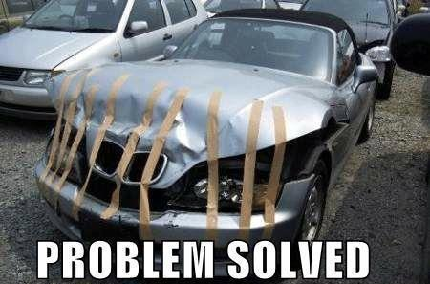

Slide 3
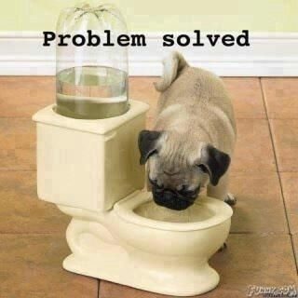

Slide 4
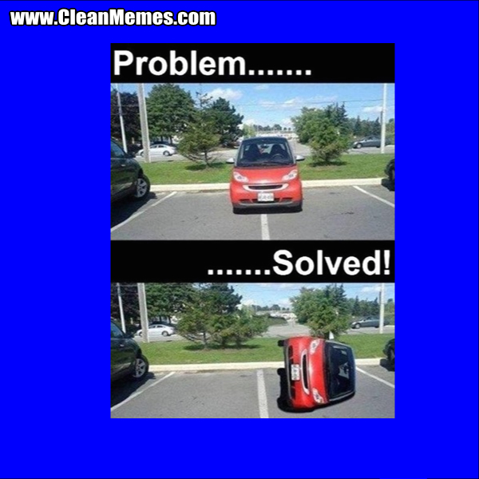

Slide 5
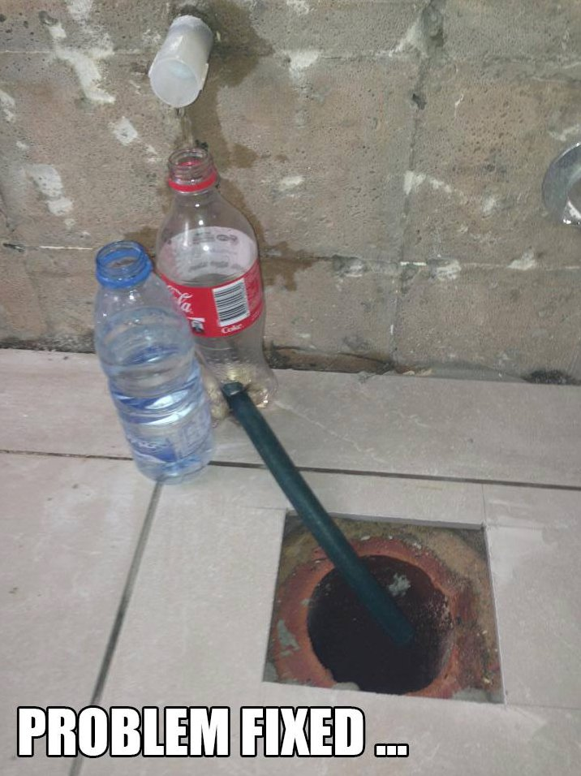

Slide 6
From organizing your DVD collection to deciding to buy a house, problem-solving makes up a large part of daily life.
Problems can range from small (solving a single math equation on your homework assignment) to very large (planning your future career).

Slide 7
Mental Processes at work during problem solving
Recognize there is a problem
Consider relevant information that applies to the current problem
Identify different aspects of the problem
Label and describe the problem

Slide 8
Common Problem solving strategies in college students
Trial-and-Error: A trial-and-error approach to problem-solving involves trying a number of different solutions and ruling out those that do not work. This approach can be a good option if you have a very limited number of options available.
      If there are many different choices, you are better off narrowing down the possible options using another problem-solving technique before attempting trial-and-error.
Insight: In some cases, the solution to a problem can appear as a sudden insight. According to researchers, insight can occur because you realize that the problem is actually similar to something that you have dealt with in the past, but in most cases the underlying mental processes that lead to insight happen outside of awareness.

Slide 9
Problems and obstacles in problem solving
Functional Fixedness: This term refers to the tendency to view problems only in their customary manner. Functional fixedness prevents people from fully seeing all of the different options that might be available to find a solution.
Irrelevant or Misleading Information: When you are trying to solve a problem, it is important to distinguish between information that is relevant to the issue and irrelevant data that can lead to faulty solutions. When a problem is very complex, the easier it becomes to focus on misleading or irrelevant information.

Slide 10
Problems and obstacles in problem solving
Assumptions: When dealing with a problem, people often make assumptions about the constraints and obstacles that prevent certain solutions.
Mental Set: Another common problem-solving obstacle is known as a mental set, which is the tendency people have to only use solutions that have worked in the past rather than looking for alternative ideas. A mental set can often be a useful problem-solving tool. However, mental sets can also lead to inflexibility, making it more difficult to find effective solutions.

Slide 11
7 steps to problem solving
Recognize and identify the Problem: While it may seem like an obvious step, identifying the problem is not always as simple as it sounds. In some cases, people might mistakenly identify the wrong source of a problem, which will make attempts to solve it inefficient or even useless.
Define the Problem: After the problem has been identified, it is important to fully define the problem so that it can be solved. 40-20-10-5
Form a Strategy: The next step is to develop a strategy to solve the problem. The approach used will vary depending upon the situation and the individual's unique preferences.
Organize Information: Before coming up with a solution, we need to first organize the available information. What do we know about the problem? What do we not know? The more information that is available, the better prepared we will be to come up with an accurate solution.

Slide 12
7 steps to problem solving
Allocate Resources: Of course, we don't always have unlimited money, time, and other resources to solve a problem. Before you begin to solve a problem, you need to determine how high priority it is. If it is an important problem, it is probably worth allocating more resources to solving it. If, however, it is a fairly unimportant problem, then you do not want to spend too much of your available resources into coming up with a solution.
Monitor Progress: Effective problem-solvers tend to monitor their progress as they work towards a solution. If they are not making good progress toward reaching their goal, they will reevaluate their approach or look for new strategies.
Evaluate the Results: After a solution has been reached, it is important to evaluate the results to determine if it is the best possible solution to the problem. This evaluation might be immediate, such as checking the results of a math problem to ensure the answer is correct, or it can be delayed, such as evaluating the success of a therapy program after several months of treatment.

Slide 13
The measure of success is not whether you have a tough problem to deal with, but whether it is the same problem you had last year.
John Foster Dulles, Former US Secretary of State

