Slide 1
Career Exploration

Slide 2
The Goal of Career Exploration
Learn about yourself
Learn about your interests
Learn what are realistic options

Slide 3
Learn About Yourself
Knowing your strengths
  Everyone does certain things better than others
    Where do you excel easily
    What situations do you find yourself ahead of others naturally
Knowing your own comfort level
  How much risk are you comfortable with?
    Working for someone in a job that is already defined verses working for yourself in a job you create
    If the career is highly competitive or in high demand are you comfortable with that?

Slide 4
Learn About Yourself
Knowing your limits
  Everyone has a limit to what is acceptable from work hours to environment
    Make certain you understand working conditions of a career
    There is nothing wrong with saying no because of comfort level
Knowing your own lifestyle goals
  Does the job pay what you need to buy the things you want?
  Does the job give you time you want with your family?
  Does the job have adventure or stability, travel required or local only, work independently or with a team, creative or repetition?
    We all have ideal situations we are drawn toward. Know what you want out of a career the most.

Slide 5
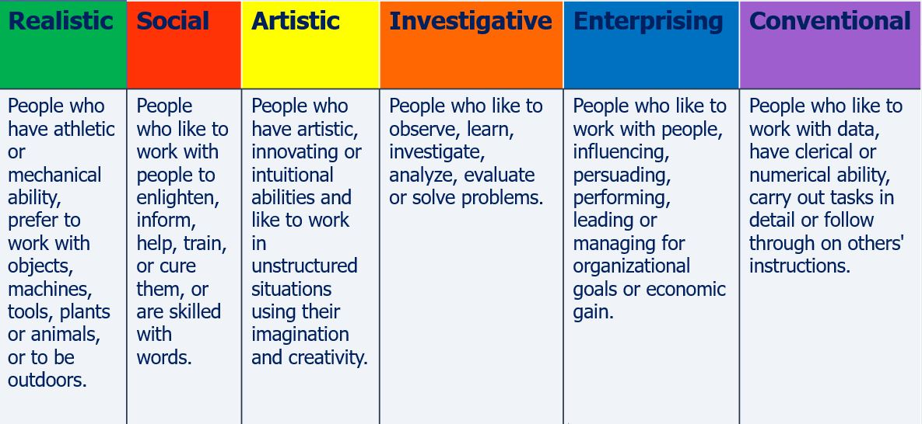
Learn About Yourself
Take a look at the Holland Code classification of personality types. Try to identify yourself. You may be a combination of two or more types.

Slide 6
Learn About Your Interests
What course work do you enjoy most?
  What are specific topics covered that interest you?
  Where you more content to read about the subject, discuss the subject in class or make a presentation about the information?
  Do you have more than one subject or more than one topic category that you enjoy?
    Make a list
    Look for commonalties
    Ask yourself how the commonalities can be combined
    Look for careers that correspond

Slide 7
Learn About What Is Possible
Have a plan.
  Even if the plan changes, it is important you have a direction that is well thought out with goals in place.
  Do not assume it will work out without your thoughtful planning.
Look at what degrees align with your interest
Look at the course requirements for the degree
  Do you have the foundation needed in order to succeed?
  If not, is there another closely related major?
Look at what level of education is required for the career you want to pursue

Slide 8
Summary
Career exploration involves:
  Learning about yourself
  Your interests
  What is possible
Ultimately, finding a career path is a cross between understanding yourself, your values, your goals, and what possible investment is required by you to get the career you are interested in getting.

